Slide 1

MAX
Unhoused Comfort Bag [Max]
10 STEPS

Slide 2

STEP 1 OF 10
About Project Helping
Kynd Kits are a program of Project Helping, a mental wellness nonprofit. Our mission is to make it ridiculously easy to volunteer because doing good is good for your mental wellness!
Learn More at ProjectHelping.org
When You Build a Kynd Kit - The Cycle of Impact

Slide 3
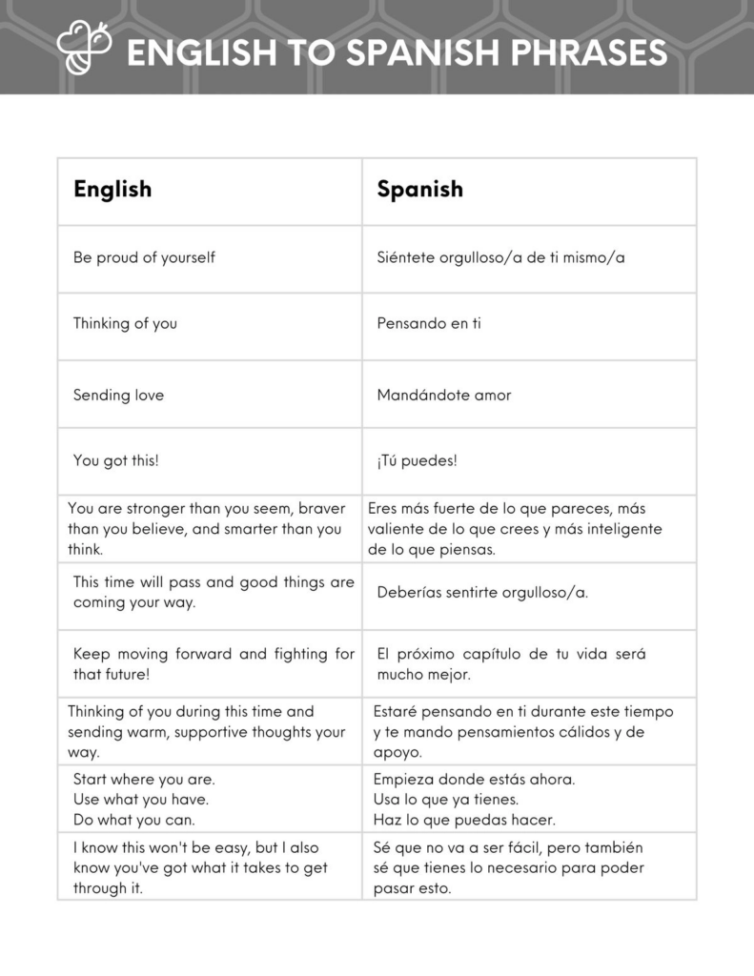
STEP 2 OF 10
Tips for Building Your Kit
Helpful Tip for Building Your Kynd Kit
• Avoid politics and religion entirely.
• Use appropriate humor.
• Can't think of what to write, draw a picture!
• Use words of affirmation!
• Place a piece of paper in any canvas bag before drawing on the outside. This way, the marker will not bleed through the other side of the bag.
• Please keep your designs gender-neutral, inclusive, and age-appropriate.
Spanish Translation Options

Slide 4
STEP 3 OF 10
Unhoused Comfort Bag [Max]
Before You Build
There are an estimated 582,462 people in the United States experiencing homelessness on a given night, according to the most recent national point-in-time estimate. This represents a rate of approximately 18 people experiencing homelessness per 10,000 people in the general population.
The most basic needs can make a world of difference to those experiencing homelessness. By making a dignity bag, you can impact someone with a meaningful, thoughtful action.

Slide 5
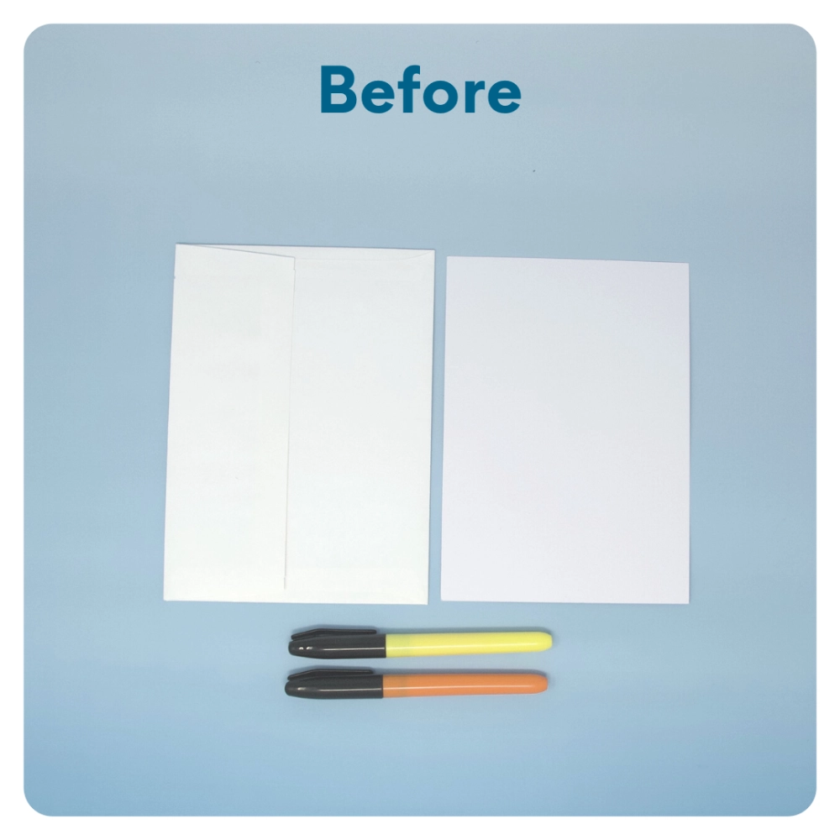
STEP 4 OF 10
Write a Note to the Recipient and Decorate the Envelope
Write a card and decorate the envelope using the enclosed materials. Express your encouragement and include a hopeful message.
Please ensure your message is age-appropriate and avoids references to religion or politics.

Slide 6
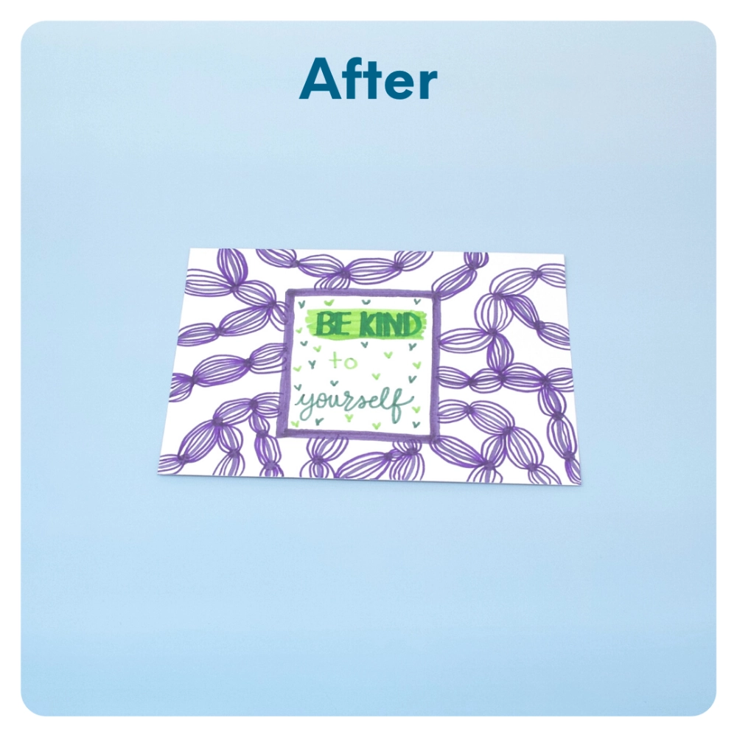
STEP 4 OF 10
Write a Note to the Recipient and Decorate the Envelope (continued)

Slide 7
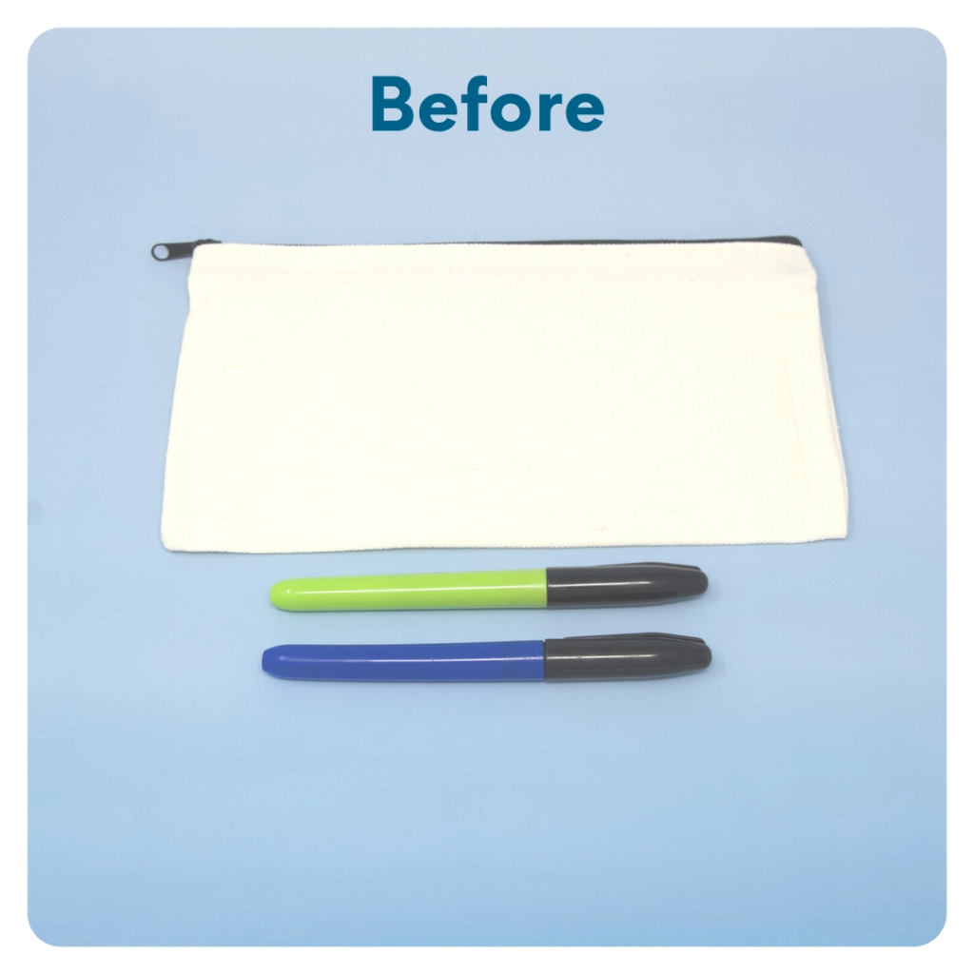
STEP 5 OF 10
Decorate the Canvas Bag
Use the permanent markers to decorate the canvas bag.
Tip: Place a piece of paper in the bag before decorating to prevent the markers from bleeding through.

Slide 8
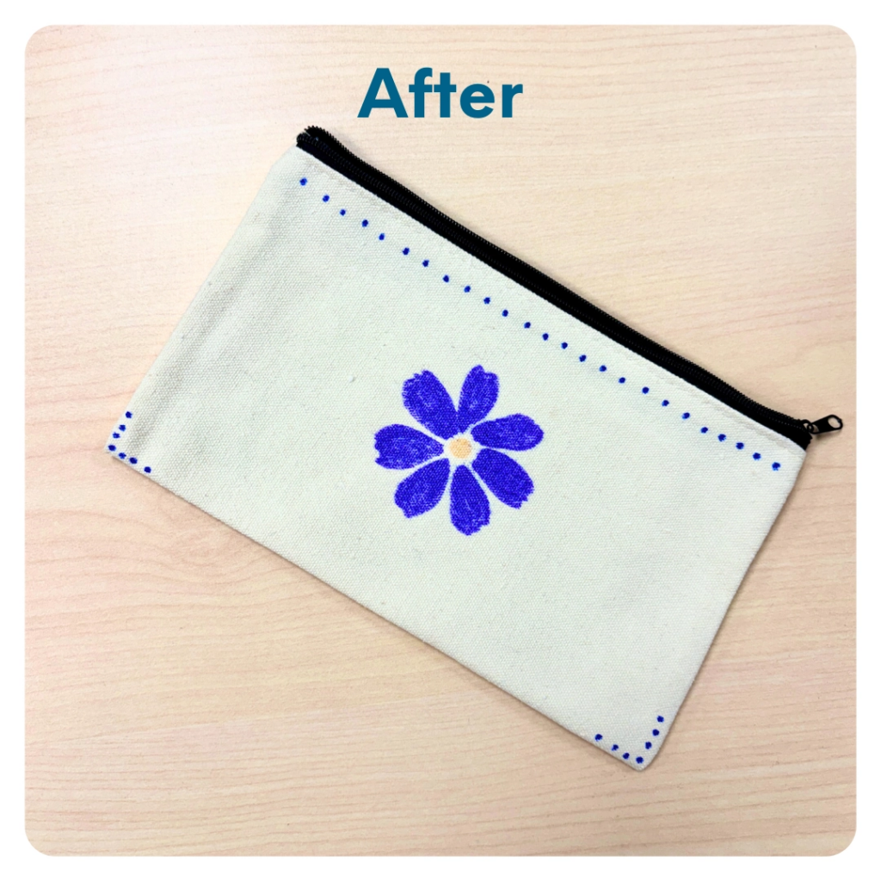
STEP 5 OF 10
Decorate the Canvas Bag (continued)

Slide 9
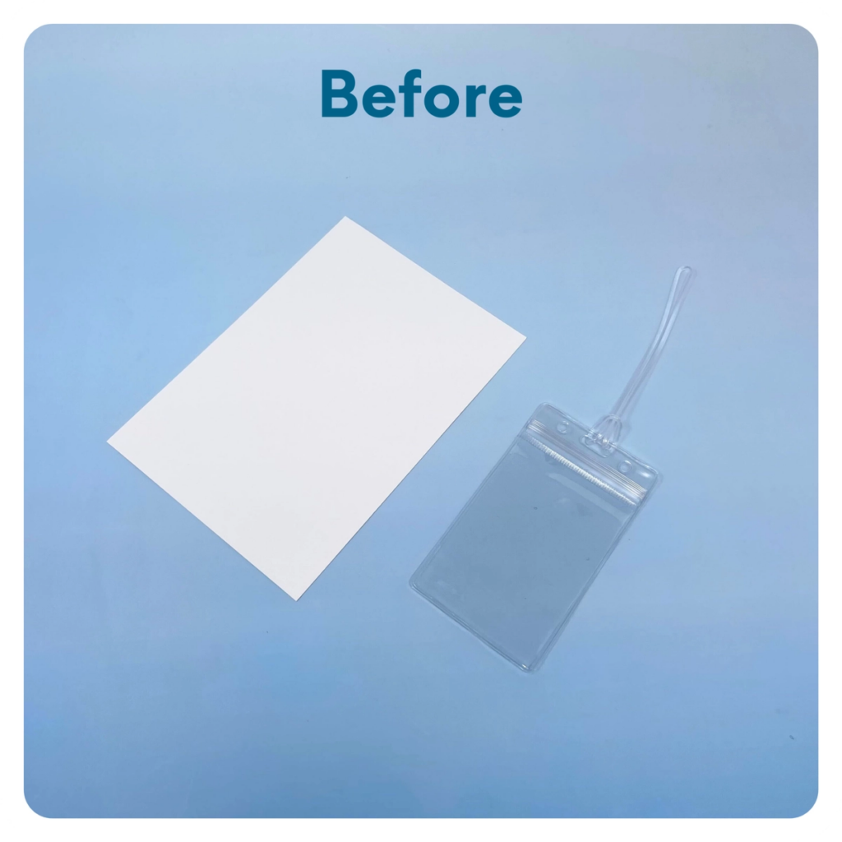
STEP 6 OF 10
Luggage Tag
Cut one of the blank cards to fit the luggage tag. Write an encouraging message, put it inside the luggage tag, and attach it to the outside of the backpack.

Slide 10
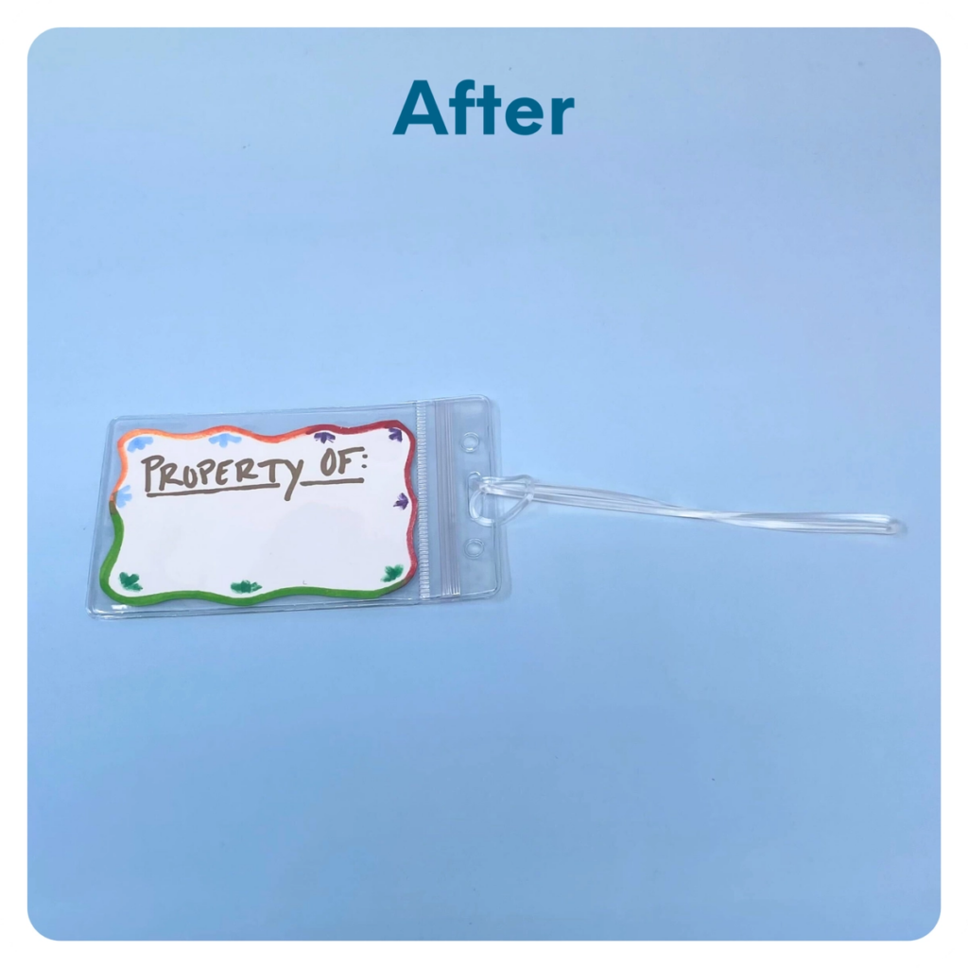
STEP 6 OF 10
Luggage Tag (continued)

Slide 11

STEP 7 OF 10
Decorate the Fan
Decorate the fan with an inspiring message or decoration. Make it cheerful and colorful!

Slide 12

STEP 7 OF 10
Decorate the Fan (continued)

Slide 13
STEP 8 OF 10
Pack The Unhoused Comfort Bag [Max]
Pack all of the materials into the backpack and put it back into the original box.
• Add any optional items you would like.
Optional Items to Add:
• Protein-rich snacks
• Hygiene items
• Basic First-aid items
• Any additional items you would like to include.
Items not to include:
• Perishable items
• Sharp objects
• Nut food products
• Religious or political items
• Alcohol

Slide 14
STEP 9 OF 10
Register My Kit (Optional)
Register your kit. To register and track your kits, you must visit the online instructions. Registering your kit is optional.

Slide 15
STEP 10 OF 10
Thank You!
When you build a Kynd Kit, you create layers of impact for yourself and the community. We appreciate your time and your support of our mission.
Cheers,
The Project Helping team

