Slide 1

MAX
Reading Nook [Max]
10 STEPS

Slide 2
STEP 1 OF 10
About Project Helping
Kynd Kits are a program of Project Helping, a mental wellness nonprofit. Our mission is to make it ridiculously easy to volunteer because doing good is good for your mental wellness!
•
•
Kynd Hub
Build your kit & track its entire journey
Create a free account at Kynd Hub — see exactly where your kit goes after you build it.
Build Your Kit on Kynd Hub
•
•
The Kynd Kit Cycle
Kynd Kits Create Impact
Every kit you build sets off a chain of good — for you, for a nonprofit, and for the whole community.

Slide 3
STEP 1 OF 10
About Project Helping (continued)
1
You Volunteer
You volunteer, which benefits your mental health and wellbeing.
•
2
Help a Nonprofit
The kit you build is donated to a vetted nonprofit partner in need.
•
3
Fund Programming
Proceeds fund free, community-based mental health programming.
•
4
Sustain the Mission
Proceeds benefit Project Helping, a 501(c)(3) nonprofit.
projecthelping.org

Slide 4
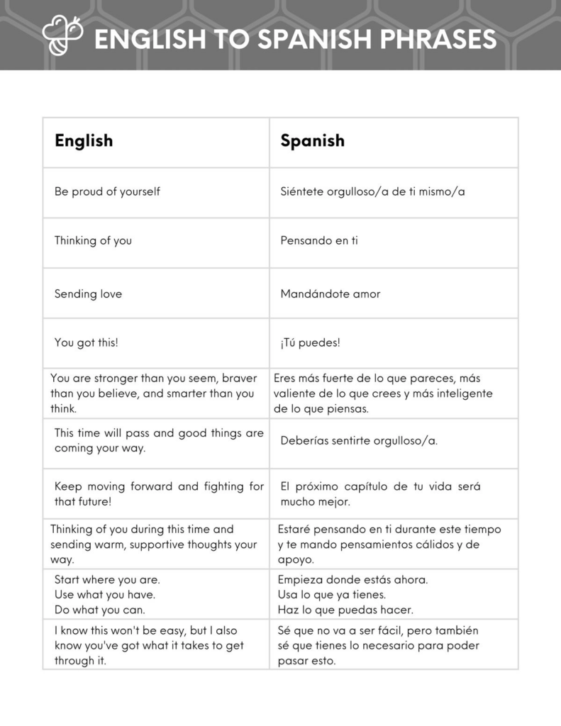
STEP 2 OF 10
Tips for Building Your Kit
Helpful Tip for Building Your Kynd Kit
• Avoid politics and religion entirely.
• Use appropriate humor.
• Can't think of what to write, draw a picture!
• Use words of affirmation!
• Place a piece of paper in any canvas bag before drawing on the outside. This way, the marker will not bleed through the other side of the bag.
• Please keep your designs gender-neutral, inclusive, and age-appropriate.
Spanish Translation Options

Slide 5
STEP 3 OF 10
Reading Nook [Max]
Before You Build
In 2024, only 31 percent of fourth-grade students in the U.S. performed at or above the NAEP Proficient level in reading, while 40 percent performed below the NAEP Basic level. These results highlight the continued need for resources that help children develop their reading skills and build confidence in reading.

Slide 6
STEP 3 OF 10
Reading Nook [Max] (continued)
Reading is about more than learning words on a page. It's about sparking imagination, building confidence, and helping children discover the joy of getting lost in a good book. This kit will be delivered to under-resourced schools and literacy organizations to support young readers.
Create a cozy reading nook for a child to encourage a love of reading and make storytime something to look forward to. You'll create a fleece tie pillow, personalized door hanger, and fun bookmarks to make their reading space feel special. Each recipient will also receive a story writing book, to write their own stories, colored pencils, mini books, a reading light, and a fidget toy to help them read, write, and let their imagination grow.
Your creations can help a child discover that reading isn't just something they learn. It's something they can love.

Slide 7
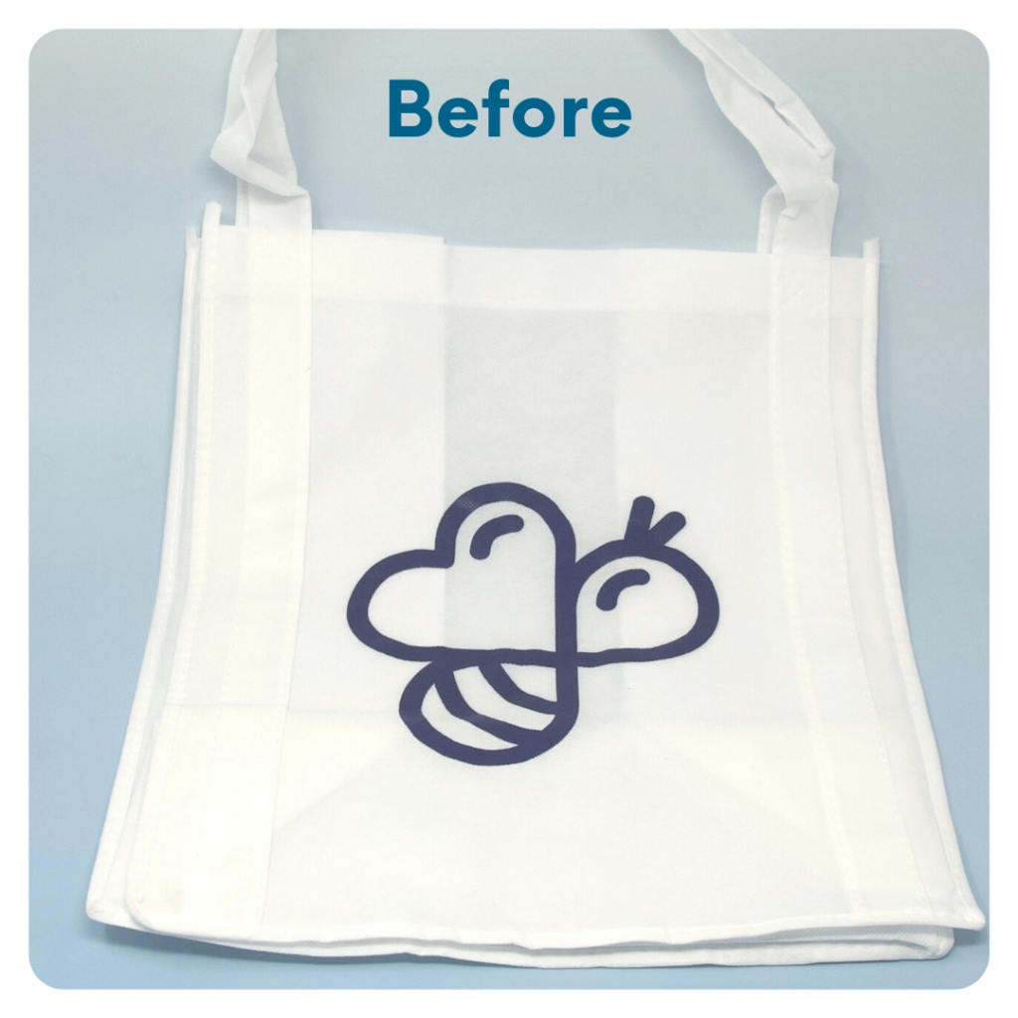
STEP 4 OF 10
DIY Tote Bag
Decorate the Canvas Tote
Decorate the canvas tote to make it fun and colorful! Tip: place a piece of paper in the tote before decorating. This will prevent the marker from bleeding through the tote.

Slide 8
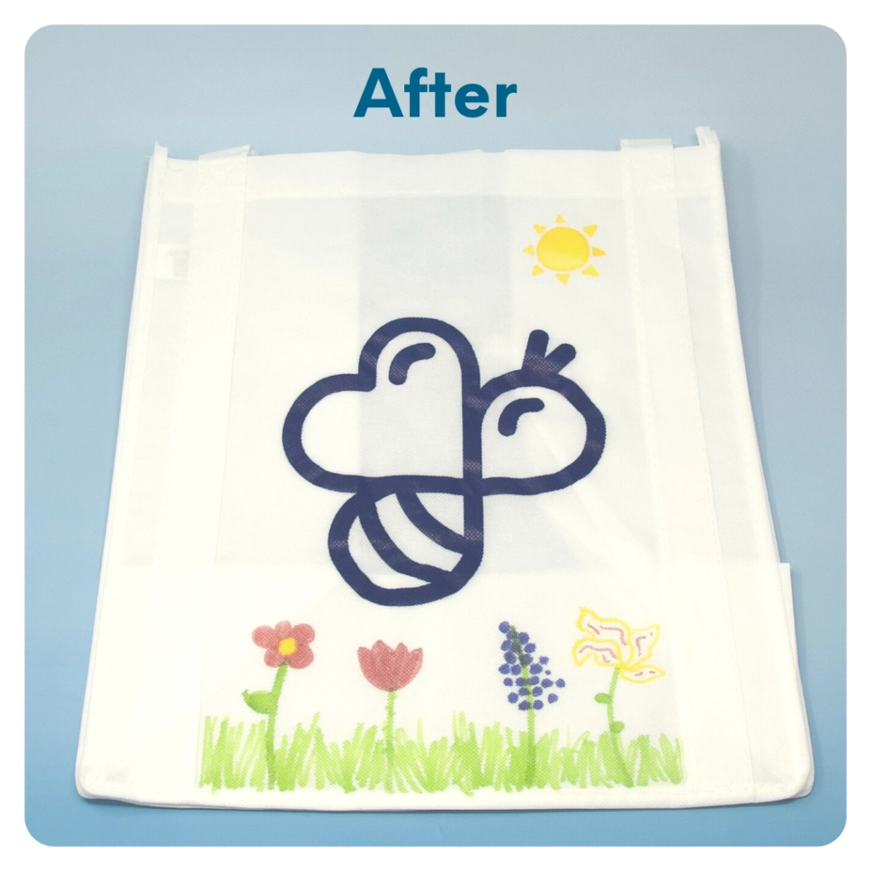
STEP 4 OF 10
DIY Tote Bag (continued)

Slide 9
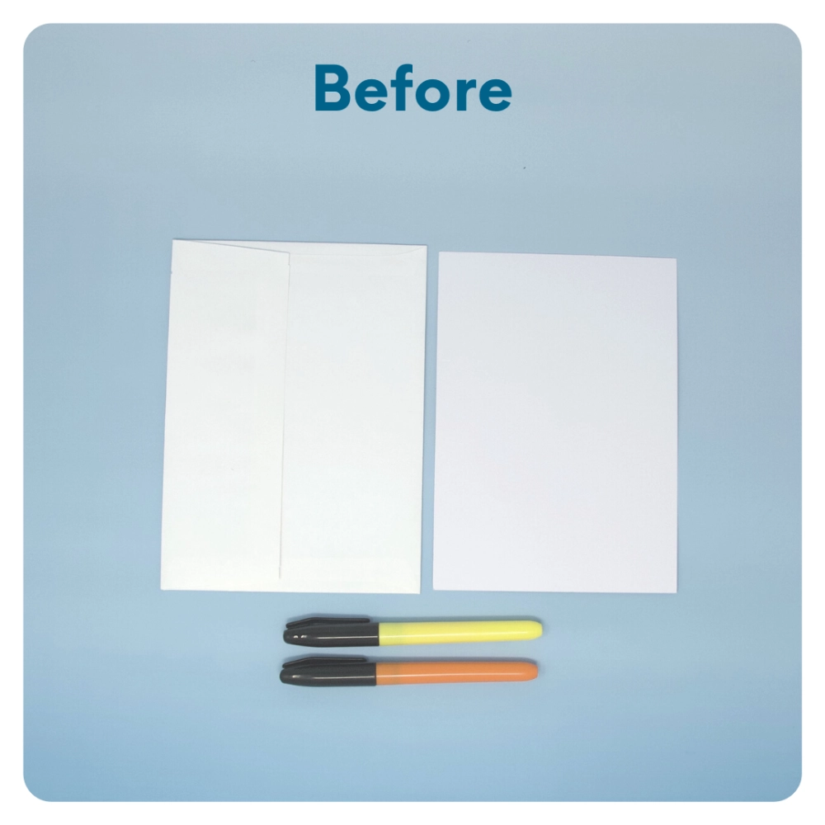
STEP 5 OF 10
Write a Note to the Recipient and Decorate the Envelope
Write a card and decorate the envelope using the enclosed materials. Express your encouragement and include a hopeful message.
Please ensure your message is age-appropriate and avoids references to religion or politics.

Slide 10
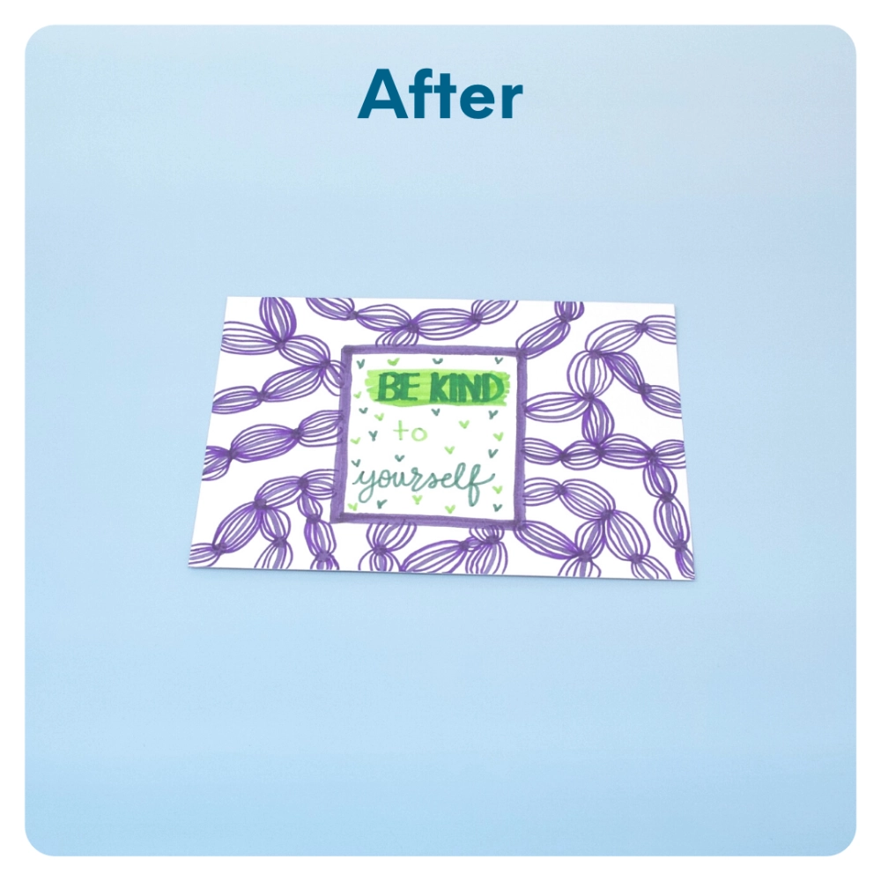
STEP 5 OF 10
Write a Note to the Recipient and Decorate the Envelope (continued)

Slide 11
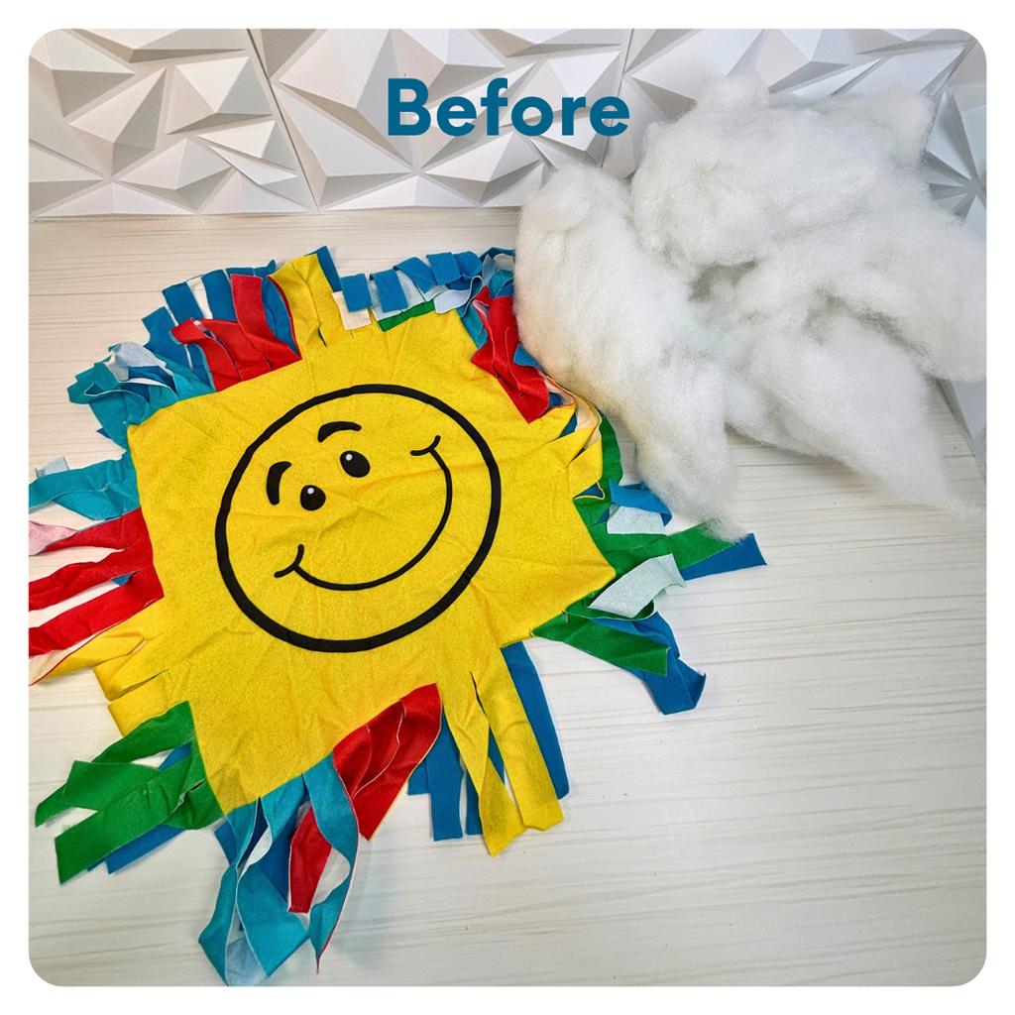
STEP 6 OF 10
Make the Fleece Pillow
• Open the fleece pillow supplies from your kit.
• Lay the front and back pieces of the pillow together, matching up the fleece ties.
• Starting at the bottom, tie the fleece strips together, then work your way up both sides.
• Before tying the top closed, add the stuffing to the pillow.
• Finish tying the top of the pillow to secure the stuffing inside.
• Go back around the pillow and tighten all the knots to ensure everything is securely tied.

Slide 12
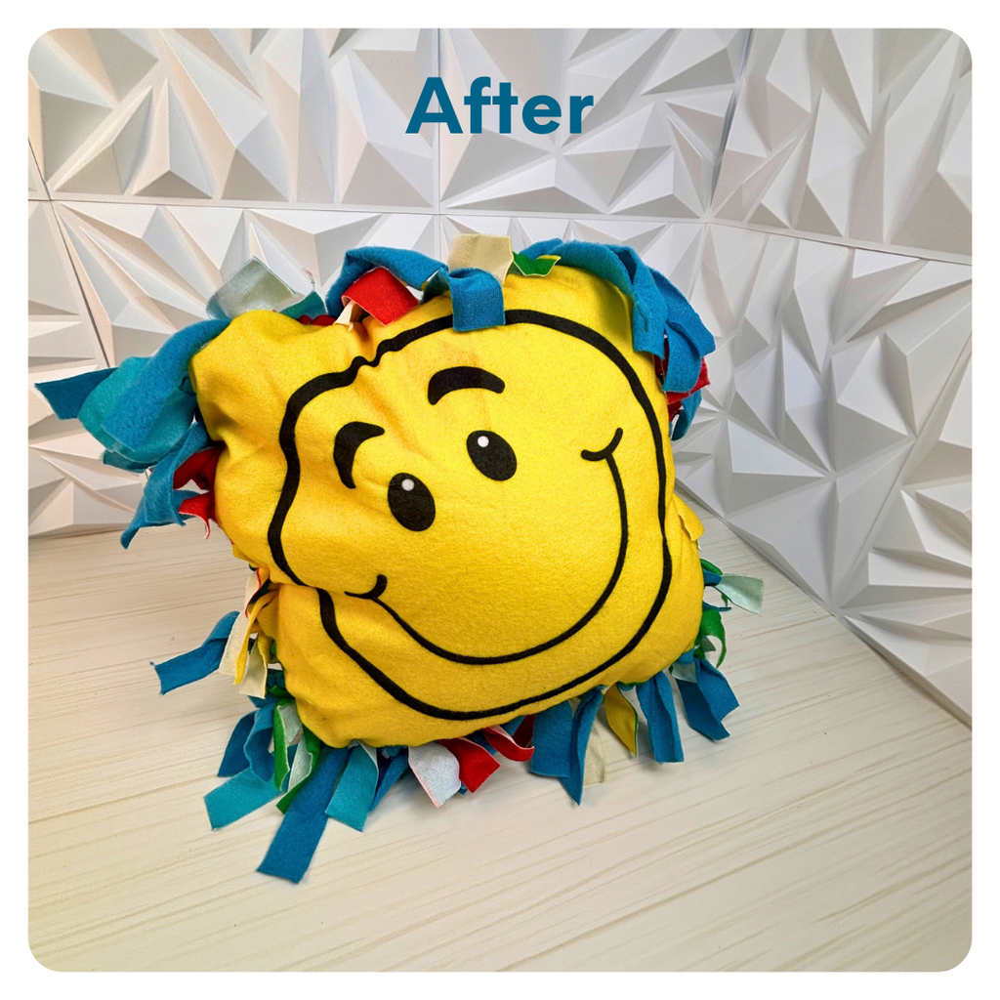
STEP 6 OF 10
Make the Fleece Pillow (continued)

Slide 13
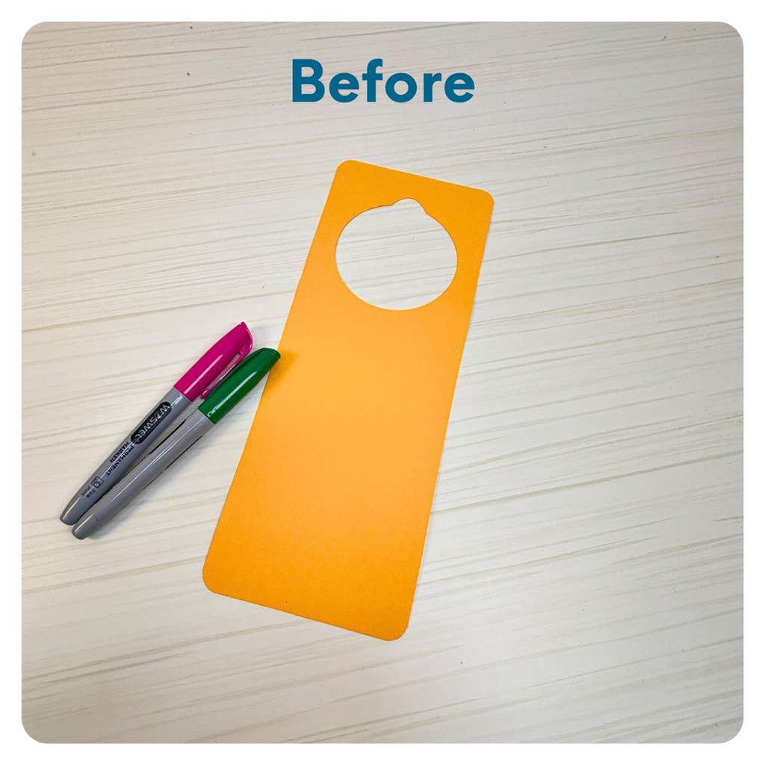
STEP 7 OF 10
Decorate the Door Hanger
Using the provided markers and stickers (if included in your kit), decorate the door hanger with fun designs, encouraging messages, or colorful artwork. Not an artist? That's OK! Get creative and make something special to help the recipient personalize their reading nook. Be sure to use age-appropriate designs and uplifting messaging.
Any unused stickers (if included in your kit) should be packed for the recipient to enjoy!

Slide 14
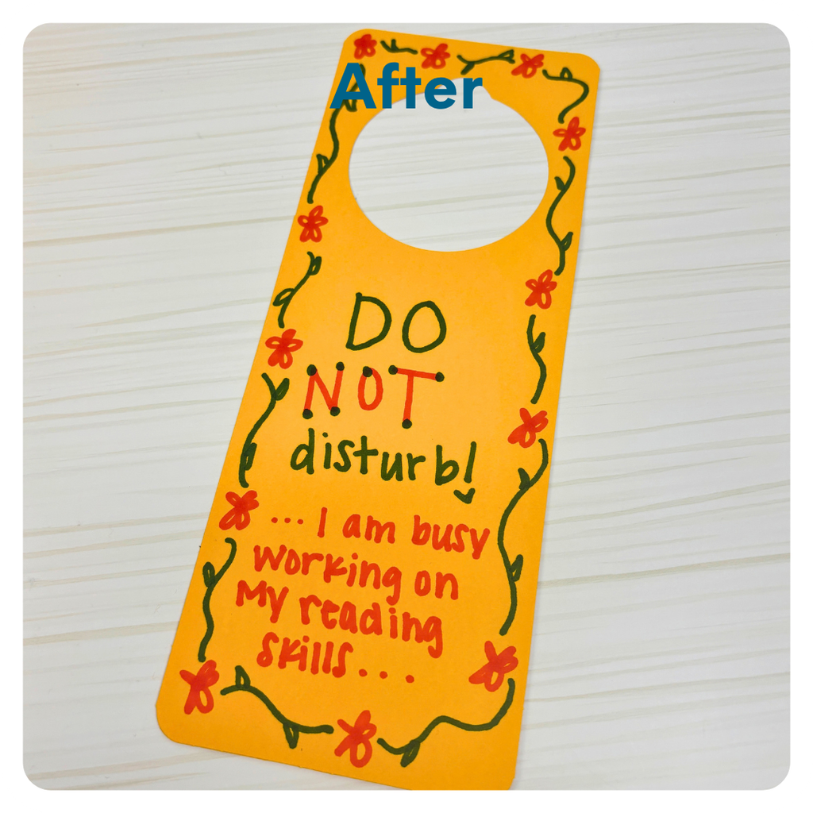
STEP 7 OF 10
Decorate the Door Hanger (continued)

Slide 15
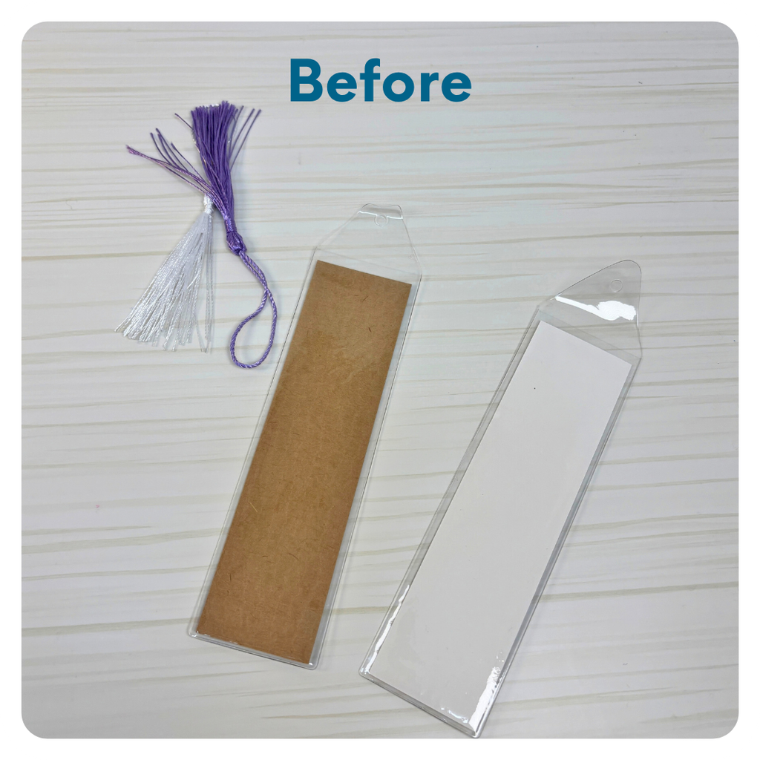
STEP 8 OF 10
Decorate the Bookmark(s)
Using the provided markers and stickers (if included in your kit), decorate the bookmarks with colorful designs and uplifting messages. Not an artist? That's OK! A few kind words can make a big impact. Be sure to use age-appropriate designs and messaging.
Any unused stickers (if included in your kit) should be packed for the recipient to enjoy!

Slide 16
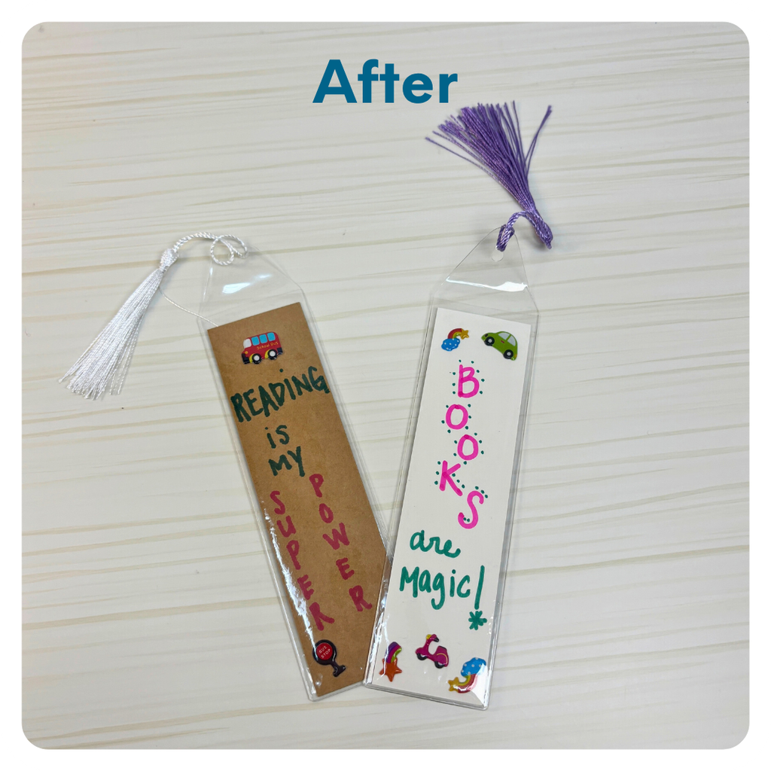
STEP 8 OF 10
Decorate the Bookmark(s) (continued)

Slide 17
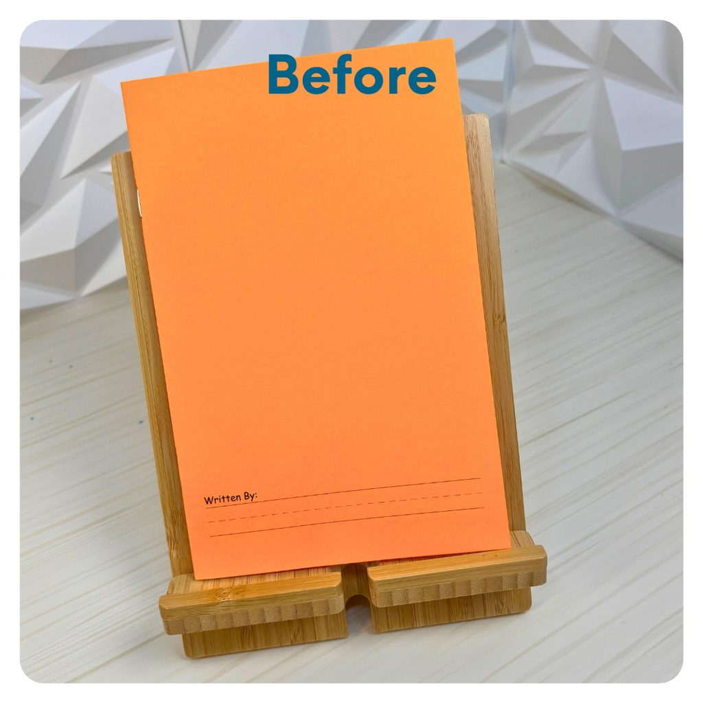
STEP 9 OF 10
Add Story Writing prompts (optional)
Want to add a little extra creativity? Feel free to write a few age-appropriate story ideas or prompts on the inside back cover of the story writing book. These can help spark the recipient's imagination and encourage them to create their own stories!
Keep your ideas fun, uplifting, and age-appropriate. Your creativity might inspire their next great adventure!

Slide 18
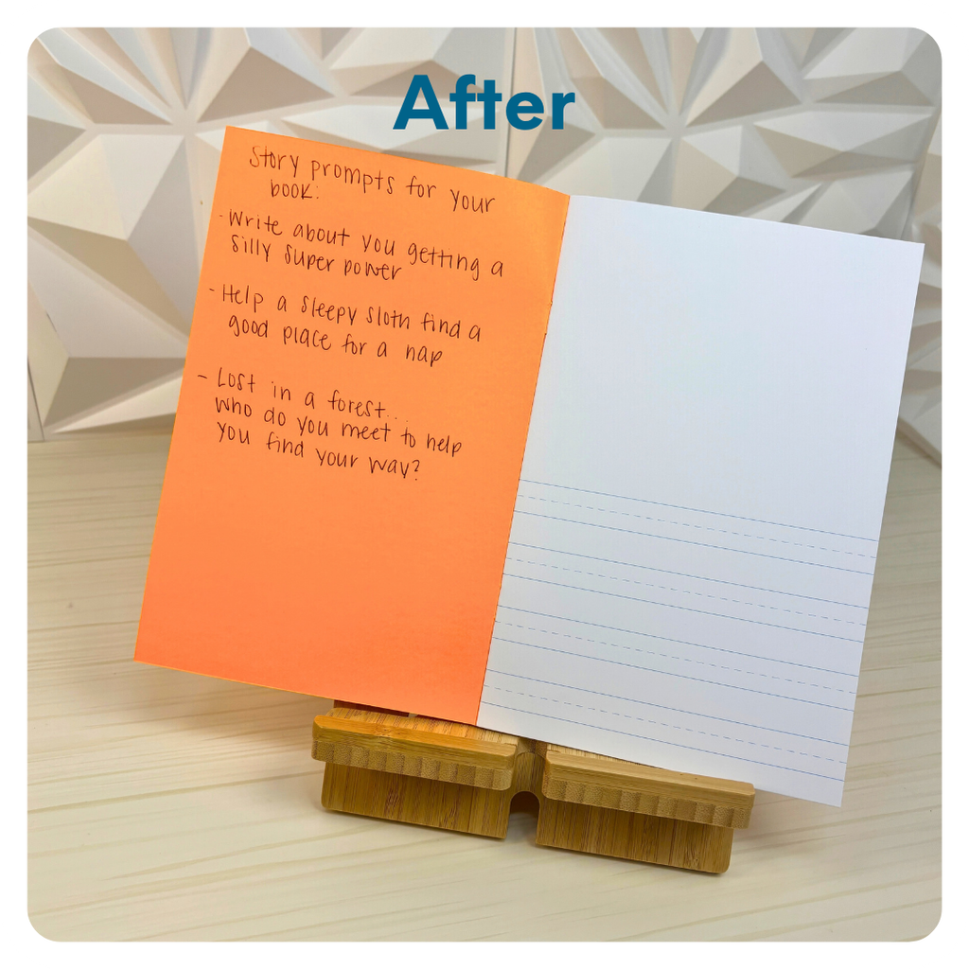
STEP 9 OF 10
Add Story Writing prompts (optional) (continued)

Slide 19
STEP 10 OF 10
Pack your Reading Nook kit
Pack all of the materials into the decorated tote bag and put it back into the original box.
• Please only include items that are UNOPENED and UNUSED
• Add any optional items you would like.
Optional Items to Add:
• Fidget toys
• Stickers
• Journals
• Coloring/writing utensils
• Other craft and art supplies
• Mini books
Items not to include:
• Perishable items
• Sharp objects
• Nut food products
• Religious or political items

