Slide 1

CLASSIC
KYND SCHOOLS &#8211; Teen Mental Health
10 STEPS

Slide 2
STEP 1 OF 10
About Project Helping
Kynd Kits are a program of Project Helping, a mental wellness nonprofit. Our mission is to make it ridiculously easy to volunteer because doing good is good for your mental wellness!
•
•
Kynd Hub
Build your kit & track its entire journey
Create a free account at Kynd Hub — see exactly where your kit goes after you build it.
Build Your Kit on Kynd Hub
•
•
The Kynd Kit Cycle
Kynd Kits Create Impact
Every kit you build sets off a chain of good — for you, for a nonprofit, and for the whole community.

Slide 3
STEP 1 OF 10
About Project Helping (continued)
1
You Volunteer
You volunteer, which benefits your mental health and wellbeing.
•
2
Help a Nonprofit
The kit you build is donated to a vetted nonprofit partner in need.
•
3
Fund Programming
Proceeds fund free, community-based mental health programming.
•
4
Sustain the Mission
Proceeds benefit Project Helping, a 501(c)(3) nonprofit.
projecthelping.org

Slide 4
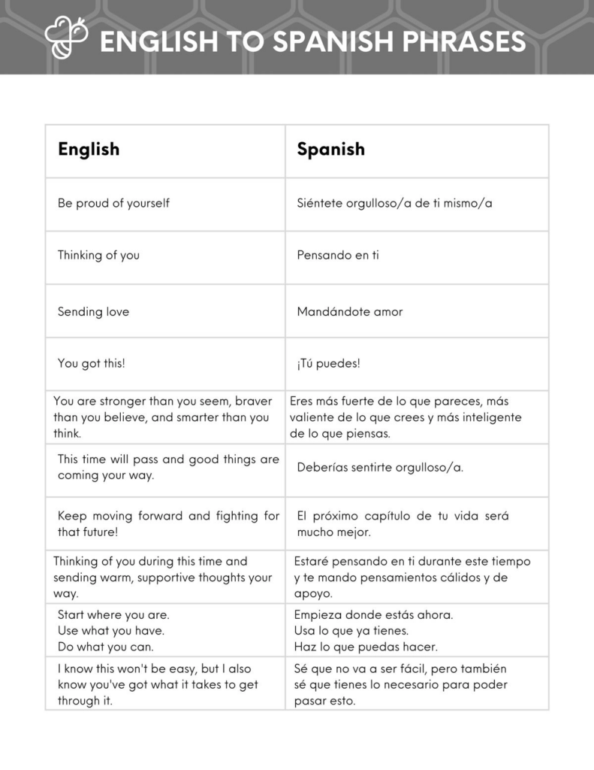
STEP 2 OF 10
Tips for Building Your Kit
Helpful Tip for Building Your Kynd Kit
• Avoid politics and religion entirely.
• Use appropriate humor.
• Can't think of what to write, draw a picture!
• Use words of affirmation!
• Place a piece of paper in any canvas bag before drawing on the outside. This way, the marker will not bleed through the other side of the bag.
• Please keep your designs gender-neutral, inclusive, and age-appropriate.
Spanish Translation Options

Slide 5
STEP 3 OF 10
Kynd Schools Teen Mental Health
Thank you for participating in our Kynd Schools Program. In these boxes, you will find all the necessary supplies and instructions to complete your volunteer experience.
About your teen mental health kynd kit:
This kit is designed to support teen mental wellness. As you personalize the DIY items, think about tools and reminders that help you manage stress, anxiety, and tough moments.

Slide 6
STEP 3 OF 10
Kynd Schools Teen Mental Health (continued)
Once your kit is complete, you are encouraged to keep it for yourself and use it whenever you need a reminder to care for your mental health. You can also choose to give it to a friend or someone who might need support.
If you’d like to pass it along but aren’t sure who to give it to, return the kit to your counselor and it will be sent back to Project Helping to share with a teen in need.

Slide 7
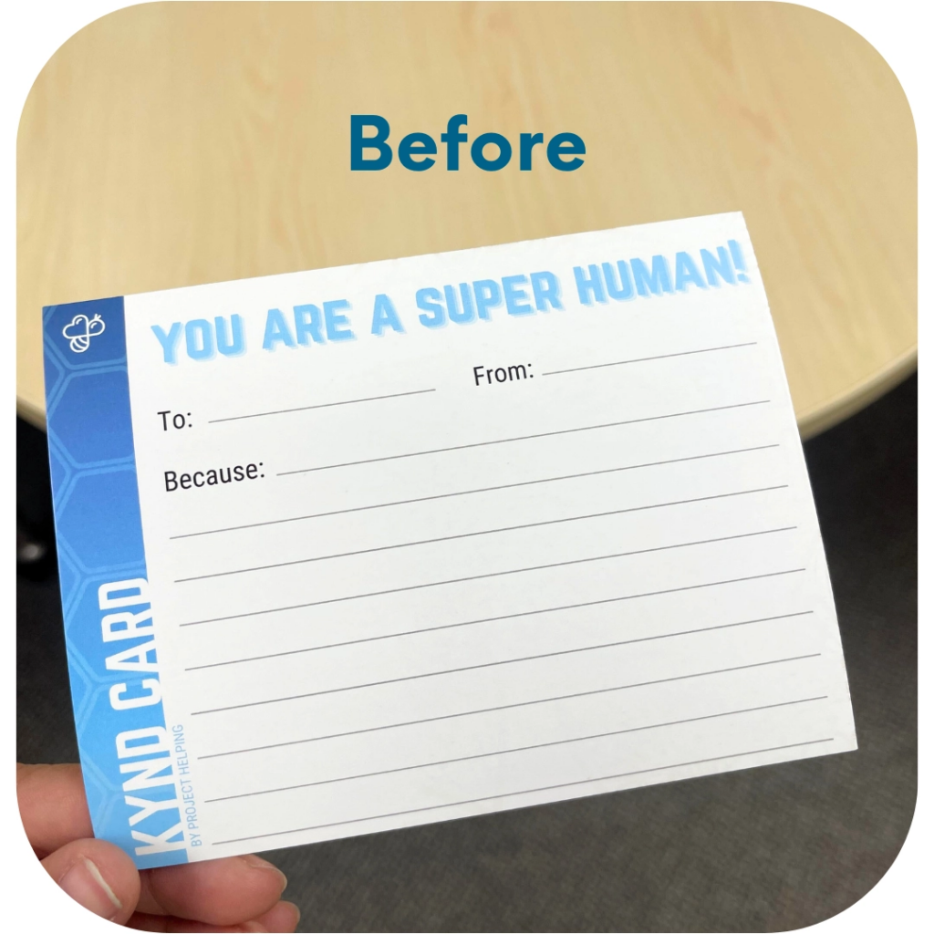
STEP 4 OF 10
Kyndness Card
Use the card to write a thoughtful note, an encouraging message, or a simple “thinking of you.” Share it with someone to brighten their day and spread a little extra kyndness.

Slide 8
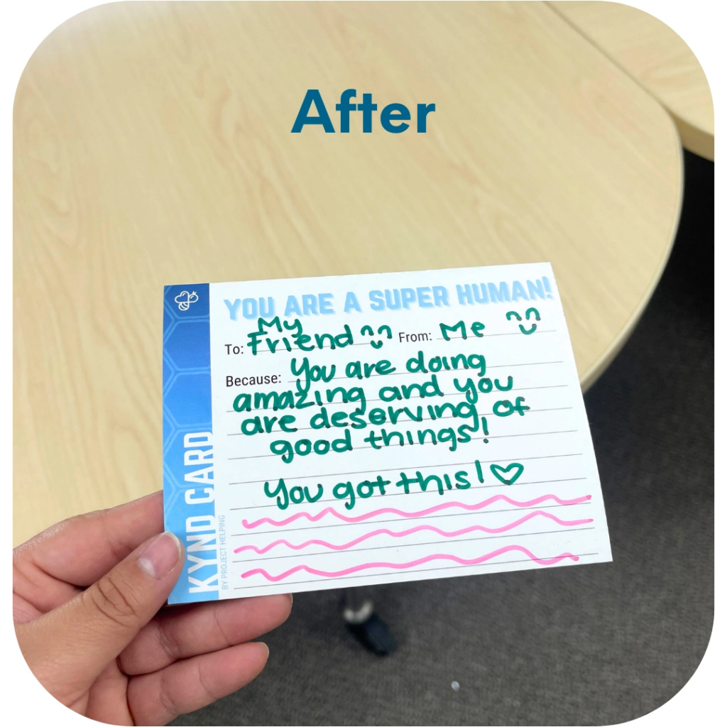
STEP 4 OF 10
Kyndness Card (continued)

Slide 9
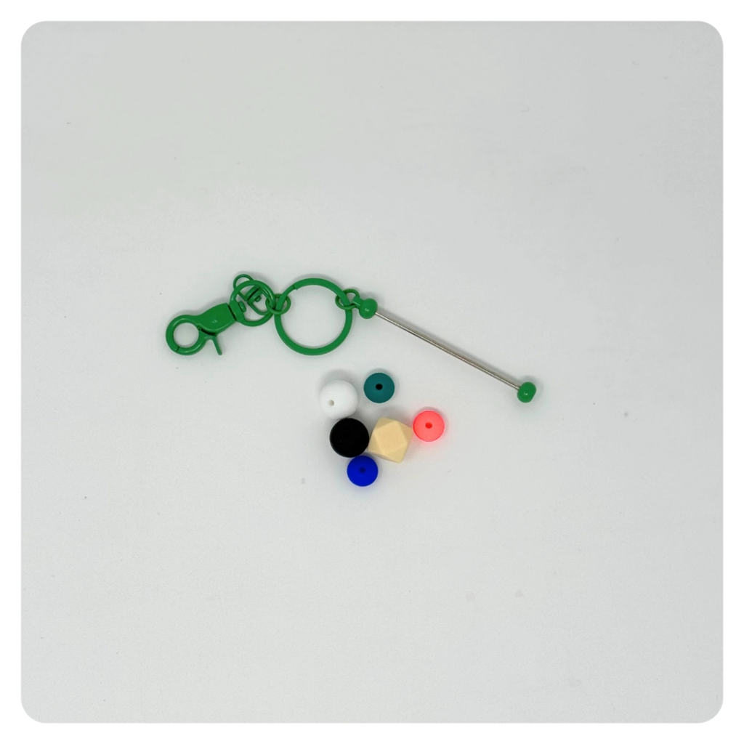
STEP 5 OF 10
Build a Fidget Keychain
Use the key chain and silicone beads to create a fidget key chain. This makes a fun, soothing tool for someone who could use a little calm and kyndness on the go.

Slide 10
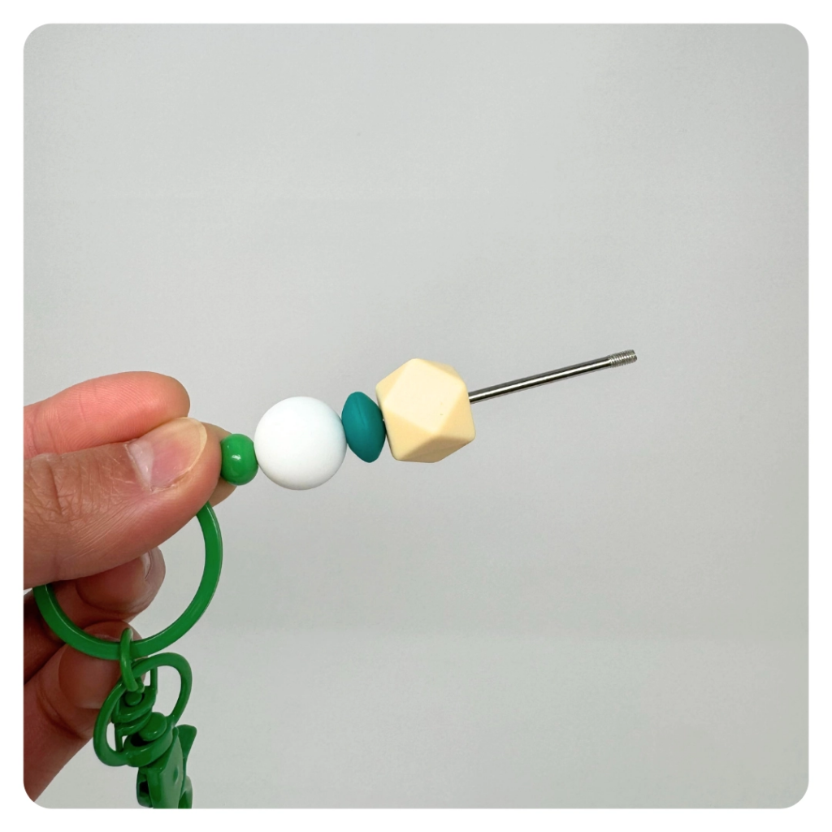
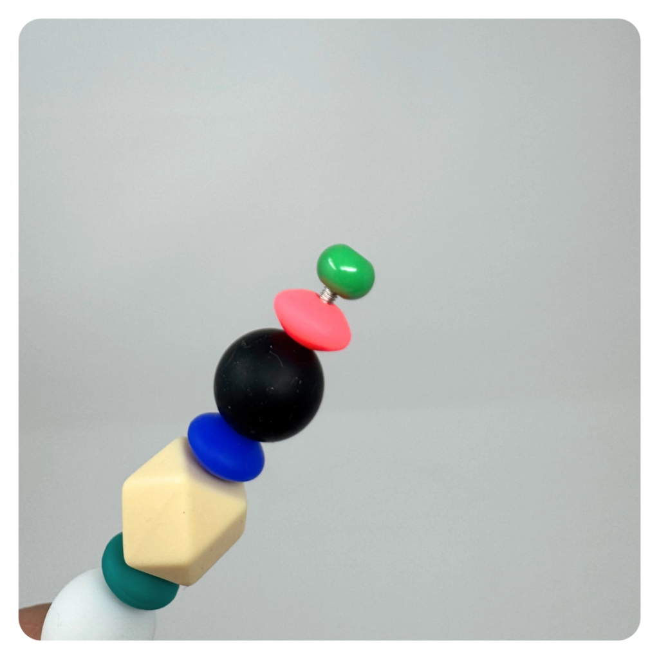
STEP 5 OF 10
Build a Fidget Keychain (continued)

Slide 11
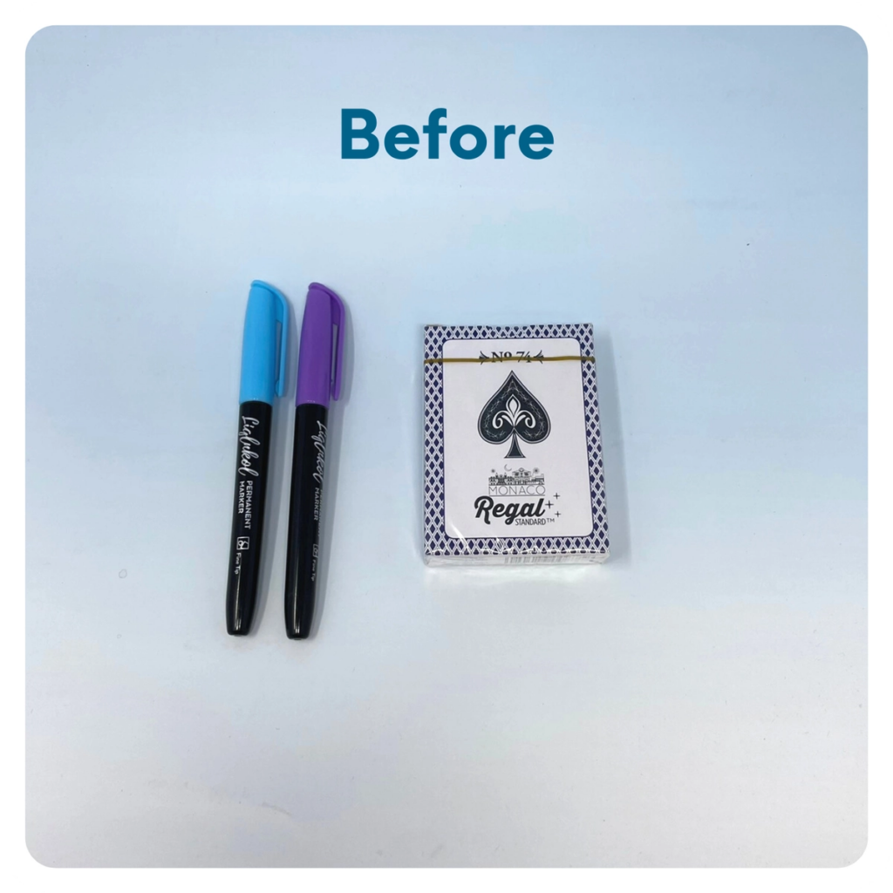
STEP 6 OF 10
Decorate the Playing Cards
Write encouraging messages, affirmations, jokes, or pictures on the faces of the playing cards for players to see when they are playing a card game.

Slide 12
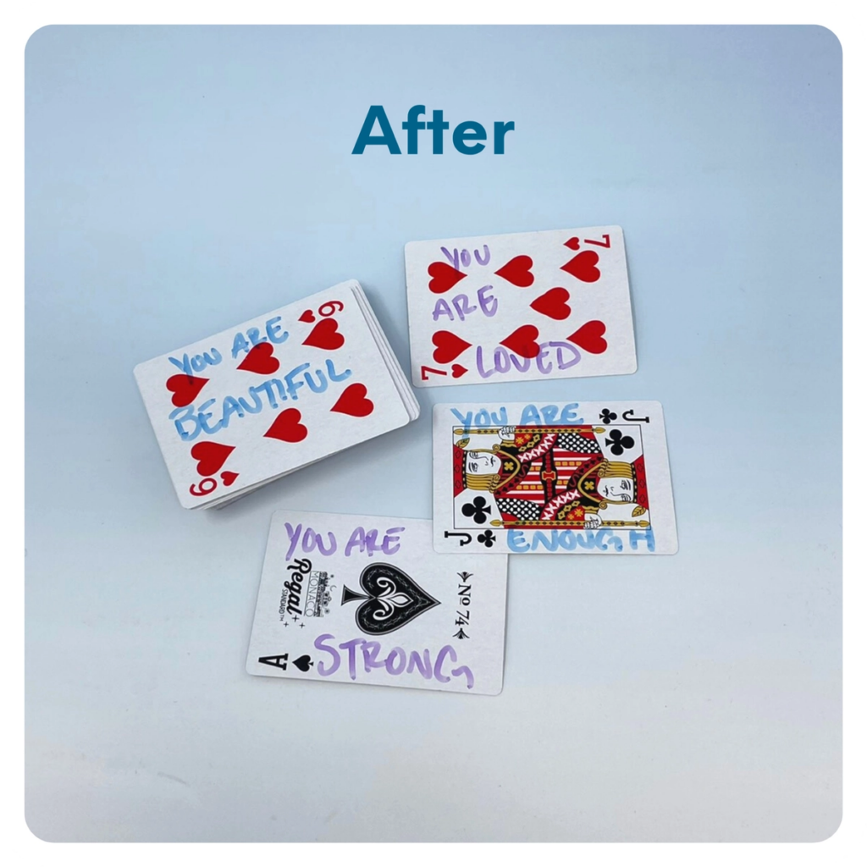
STEP 6 OF 10
Decorate the Playing Cards (continued)

Slide 13
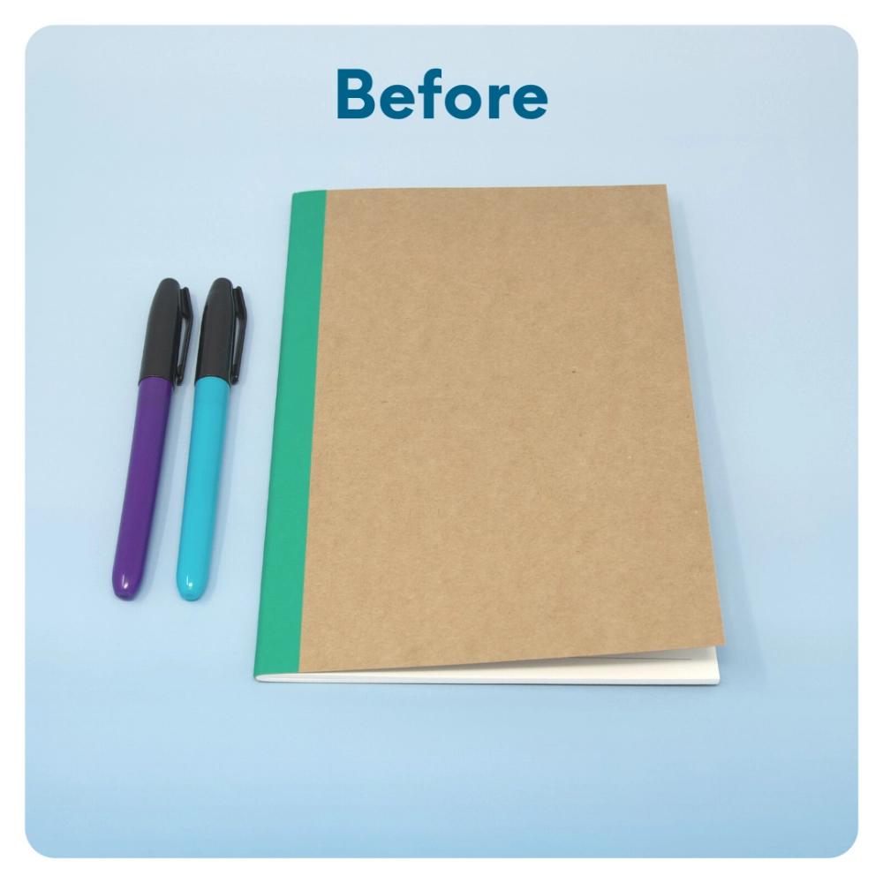
STEP 7 OF 10
Surprise Kyndness Notebook
Decorate the outside of the journal with a picture or uplifting message. Use random pages in the journal to write short, uplifting messages, draw small, colorful images, or create fun writing prompts for the recipient.

Slide 14
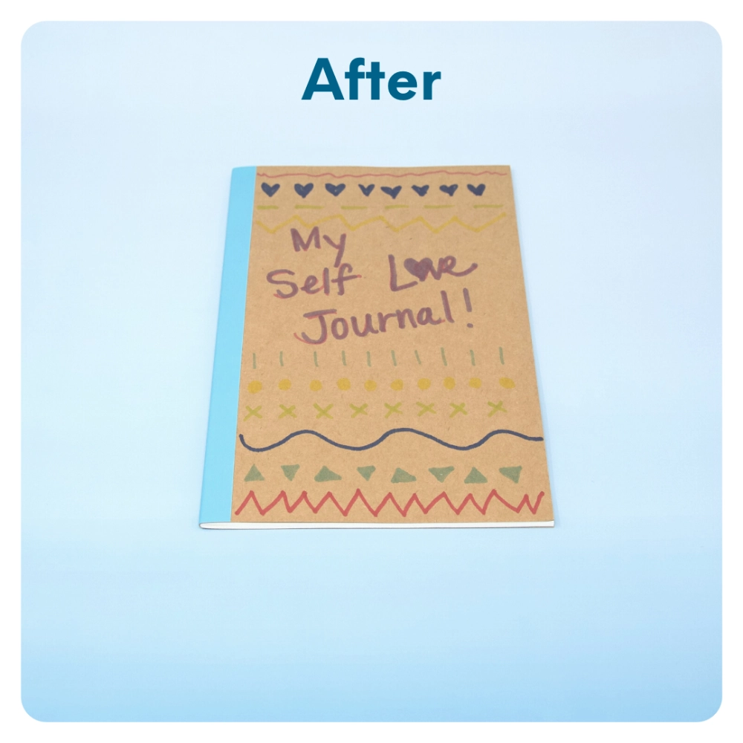
STEP 7 OF 10
Surprise Kyndness Notebook (continued)

Slide 15
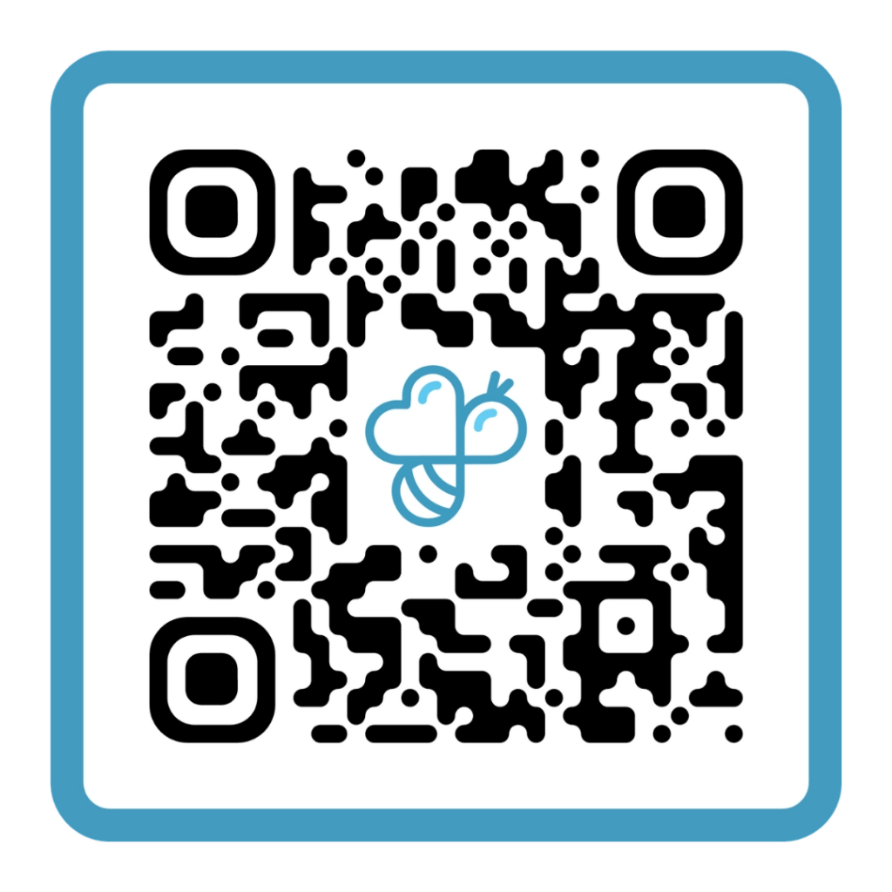
STEP 8 OF 10
Complete the survey
Follow the QR code to the online survey! We’d love your feedback.

Slide 16
STEP 9 OF 10
Pack your Kynd School Mental Health Kit
After completing all the activities, place all items back into the original box. You can decorate the box, too!
Please only include items that are unused and unopened.
Kit Distribution: This kit is yours to keep or share with a friend who may need a little extra support. Remember, taking time to care for your own mental health is important, too! 💙

Slide 17
STEP 10 OF 10
Thank You!
When you build a Kynd Kit, you create layers of impact for yourself and the community. We appreciate your time and your support of our mission.
Cheers,
The Project Helping team

