Slide 1
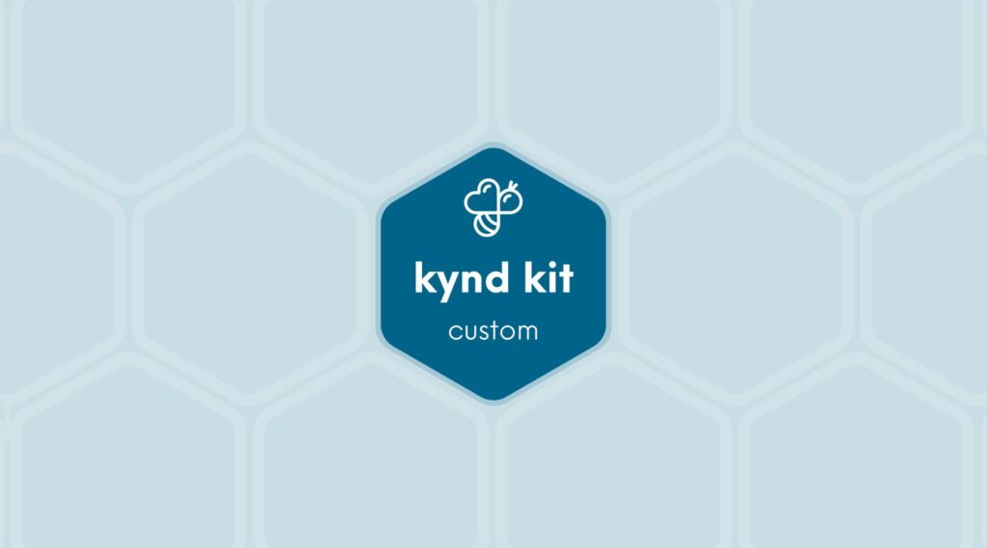
CUSTOM
AIT &#8211; Cancer Support [Custom]
10 STEPS

Slide 2
STEP 1 OF 10
About Project Helping
Kynd Kits are a program of Project Helping, a mental wellness nonprofit. Our mission is to make it ridiculously easy to volunteer because doing good is good for your mental wellness!
•
•
Kynd Hub
Build your kit & track its entire journey
Create a free account at Kynd Hub — see exactly where your kit goes after you build it.
Build Your Kit on Kynd Hub
•
•
The Kynd Kit Cycle
Kynd Kits Create Impact
Every kit you build sets off a chain of good — for you, for a nonprofit, and for the whole community.

Slide 3
STEP 1 OF 10
About Project Helping (continued)
1
You Volunteer
You volunteer, which benefits your mental health and wellbeing.
•
2
Help a Nonprofit
The kit you build is donated to a vetted nonprofit partner in need.
•
3
Fund Programming
Proceeds fund free, community-based mental health programming.
•
4
Sustain the Mission
Proceeds benefit Project Helping, a 501(c)(3) nonprofit.
projecthelping.org

Slide 4
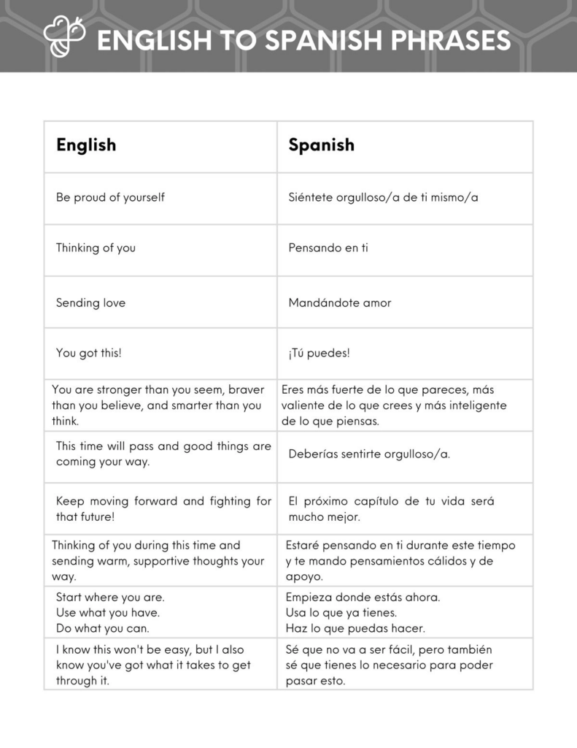
STEP 2 OF 10
Tips for Building Your Kit
Helpful Tip for Building Your Kynd Kit
• Avoid politics and religion entirely.
• Use appropriate humor.
• Can't think of what to write, draw a picture!
• Use words of affirmation!
• Place a piece of paper in any canvas bag before drawing on the outside. This way, the marker will not bleed through the other side of the bag.
• Please keep your designs gender-neutral, inclusive, and age-appropriate.
Spanish Translation Options

Slide 5
STEP 3 OF 10
Your Impact with AIT
Campaign Purpose

Slide 6
STEP 3 OF 10
Your Impact with AIT (continued)
As part of AITCares’ Fighting Cancer pillar, this comfort kit activity brings teammates together to support individuals and families impacted by cancer while demonstrating the compassion and community that define AIT. By assembling comfort kits for patients served by Corporate Angel Network (CAN), we are transforming our commitment to fighting cancer into meaningful action. This initiative also provides an opportunity to stand alongside our fellow AIT teammates who are cancer survivors, those currently navigating their own cancer journey, and the loved one who have been affected by this disease.
Campaign Impact
The comfort kits assembled during this event will be donated to Corporate Angel Network (CAN), helping provide comfort and encouragement to cancer patients traveling for treatment. Every kit serves as a tangible reminder that patients are support by a community that cares. Through this collective effort, AIT teammates are helping bring hope, comfort, and compassion to those facing cancer while reinforcing AITCare’s mission. Together, we are making a meaningful difference, one kit and one act of kindness at a time.

Slide 7
STEP 4 OF 10
Example Phrases To Use
Before You Build
These kits will be shared with families and individuals facing difficult or uncertain times in the hospital. Your thoughtful, kind words can make a difficult day a little brighter—thank you for helping spread care and compassion.
DO
• Be positive: Focus on hope, comfort, and inner strength.
• Use affirming and uplifting words: Offer gentle encouragement and warmth.
• Keep it simple and sincere: Short, heartfelt messages are best.
• Use inclusive language: Avoid assumptions, as well as political, religious, or gendered terms.

Slide 8
STEP 4 OF 10
Example Phrases To Use (continued)
• Keep the tone gentle and compassionate: Avoid intensity or emotional pressure.
AVOID
• Mentioning illness, diagnosis, or recovery (e.g., “hope you heal soon”).
• Giving advice, instructions, or making assumptions about feelings.
• Using humor, sarcasm, or quotes from public figures.
• Including personal information or full names.
• Using timelines or future outcomes (e.g., “You’ll be home soon,” “Things will get better soon”).
SAMPLE NOTES “You are surrounded by care and kindness.” “Wishing you calm, strength, and comfort today.” “You are not alone—there are people thinking of you.” “May this note remind you that you’re cared for and supported.”

Slide 9
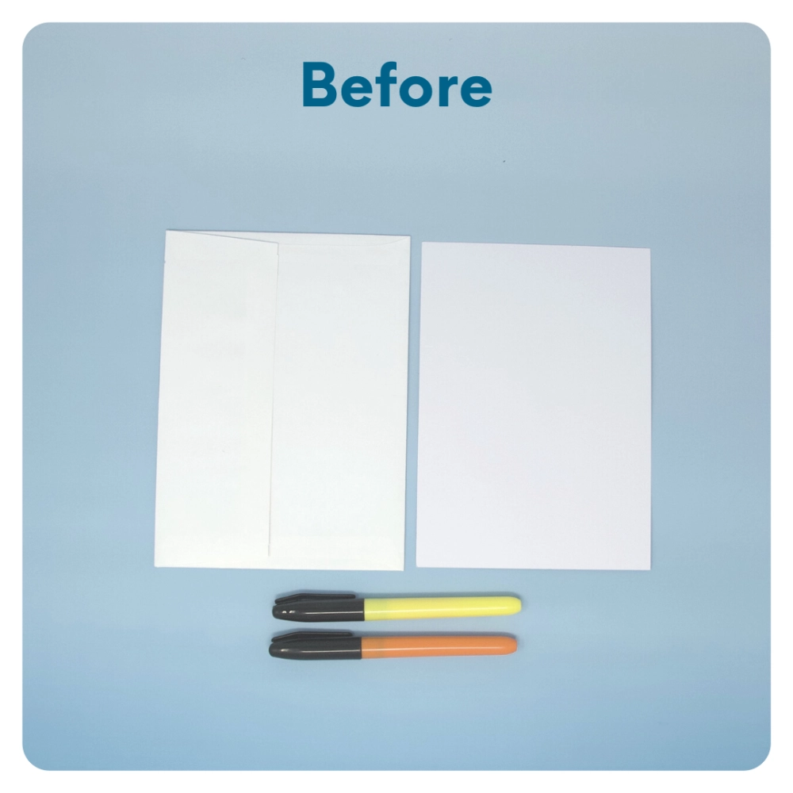
STEP 5 OF 10
Write a Note to the Recipient and Decorate the Envelope
Write a card and decorate the envelope using the enclosed materials. Express your encouragement and include a hopeful message.
Please ensure your message is age-appropriate and avoids references to religion or politics.

Slide 10
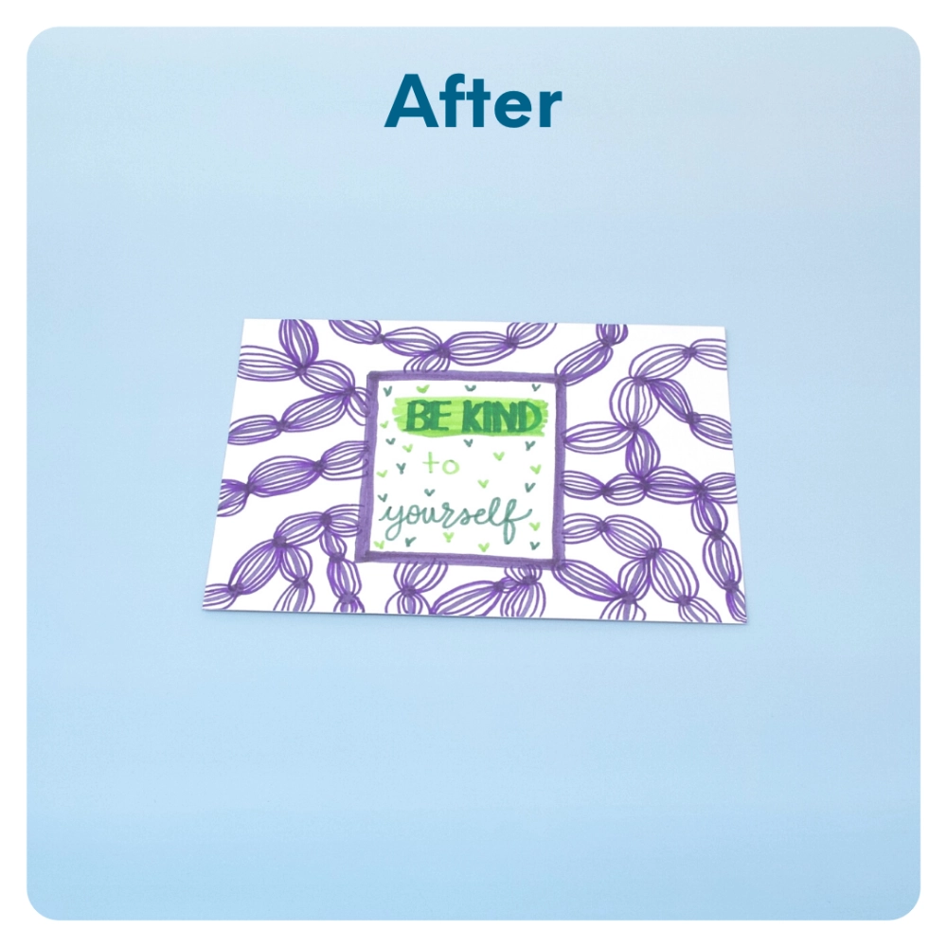
STEP 5 OF 10
Write a Note to the Recipient and Decorate the Envelope (continued)

Slide 11
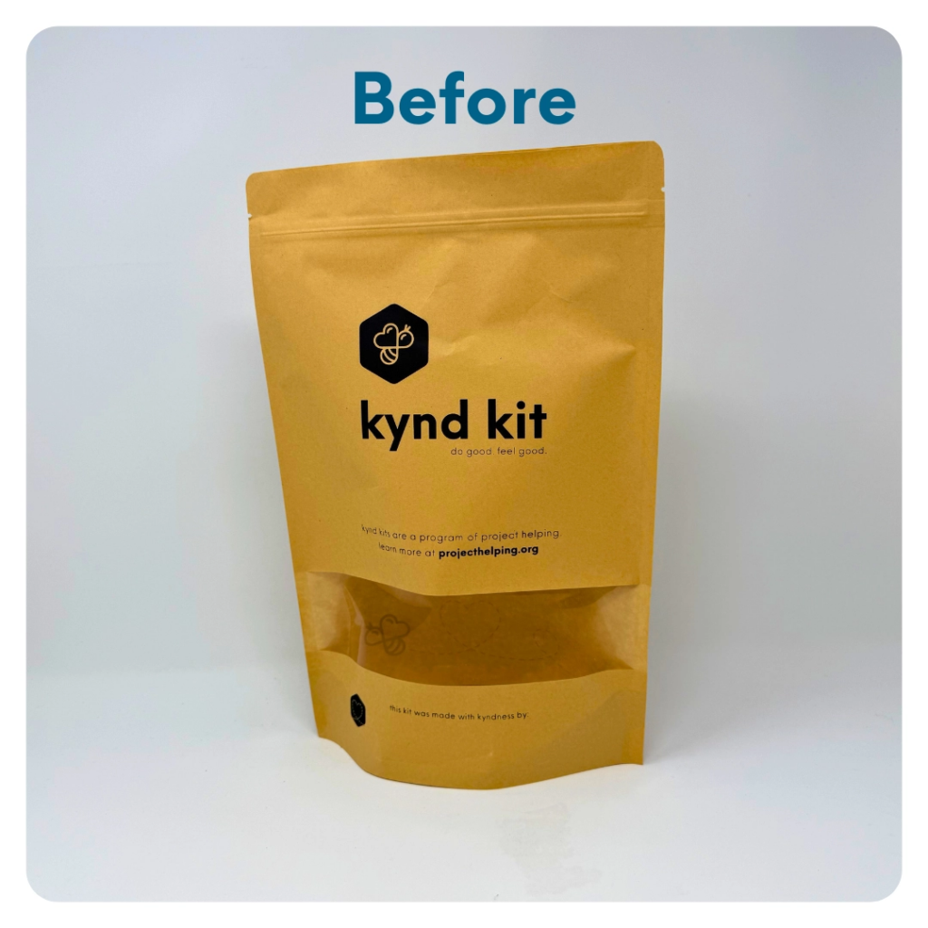
STEP 6 OF 10
Decorate the Bag
Decorate the kraft bag(s). This is what the final kit is distributed in, so try to make this fun and colorful for the recipient to open.
Please note: we are currently transitioning from plastic ziplock bags to kraft bags. Some kits may still include the plastic bag for you to decorate while we complete this transition.

Slide 12
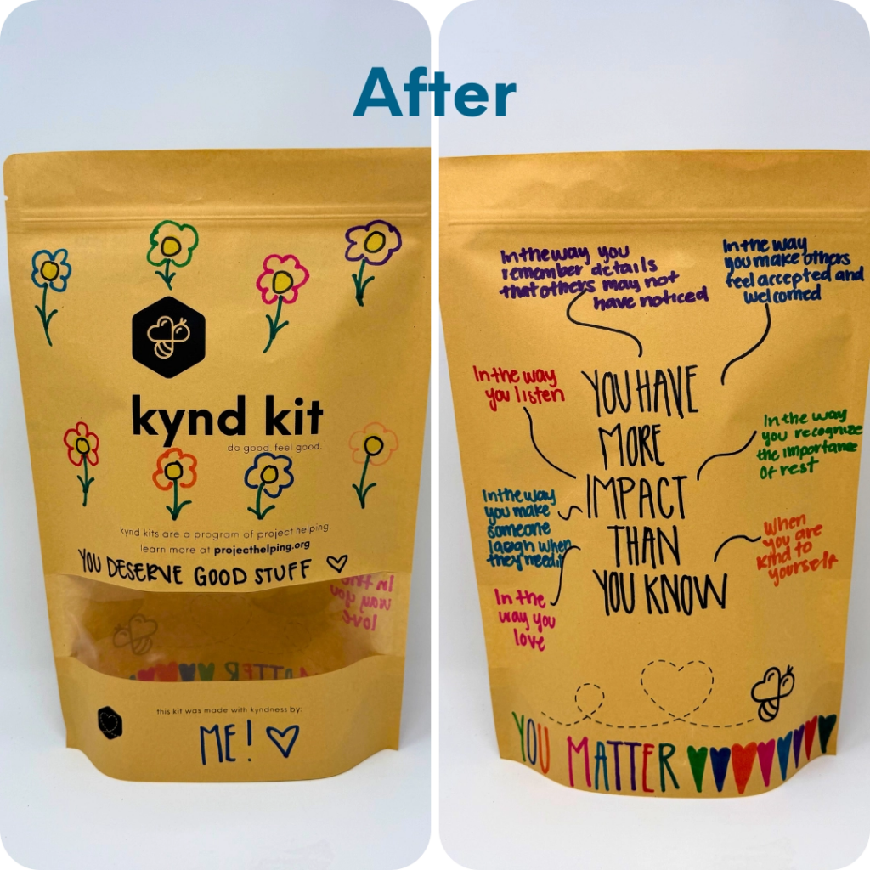
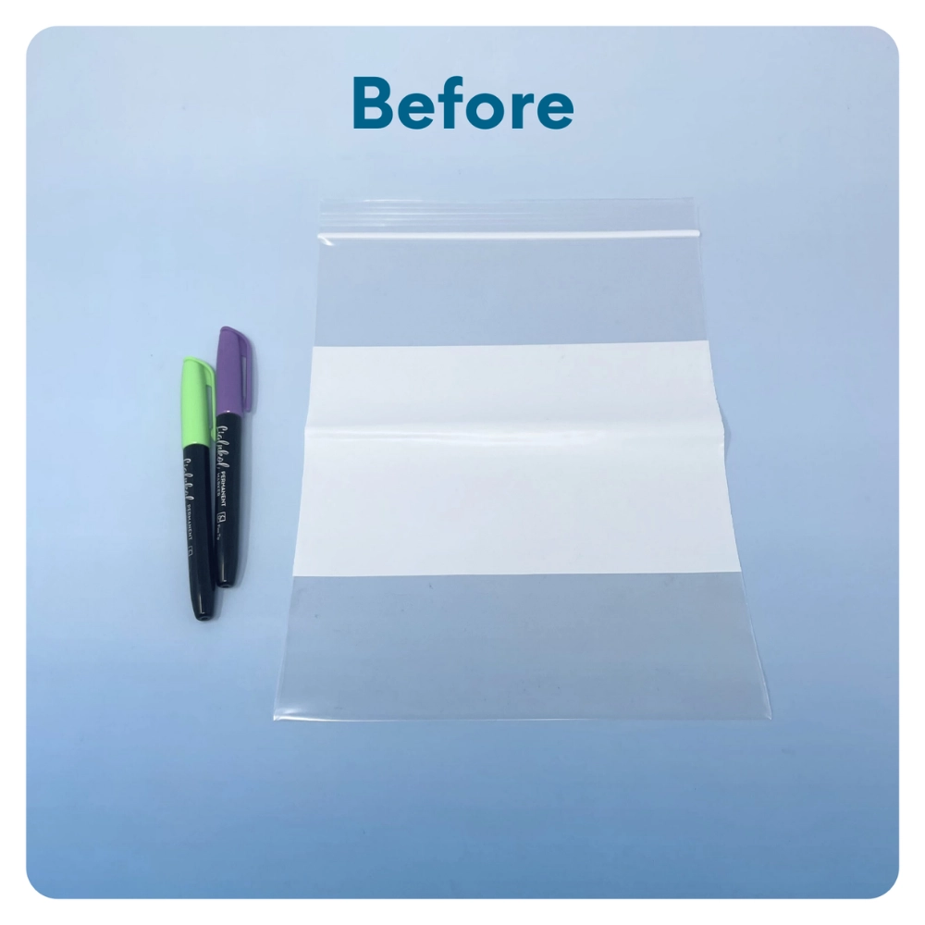
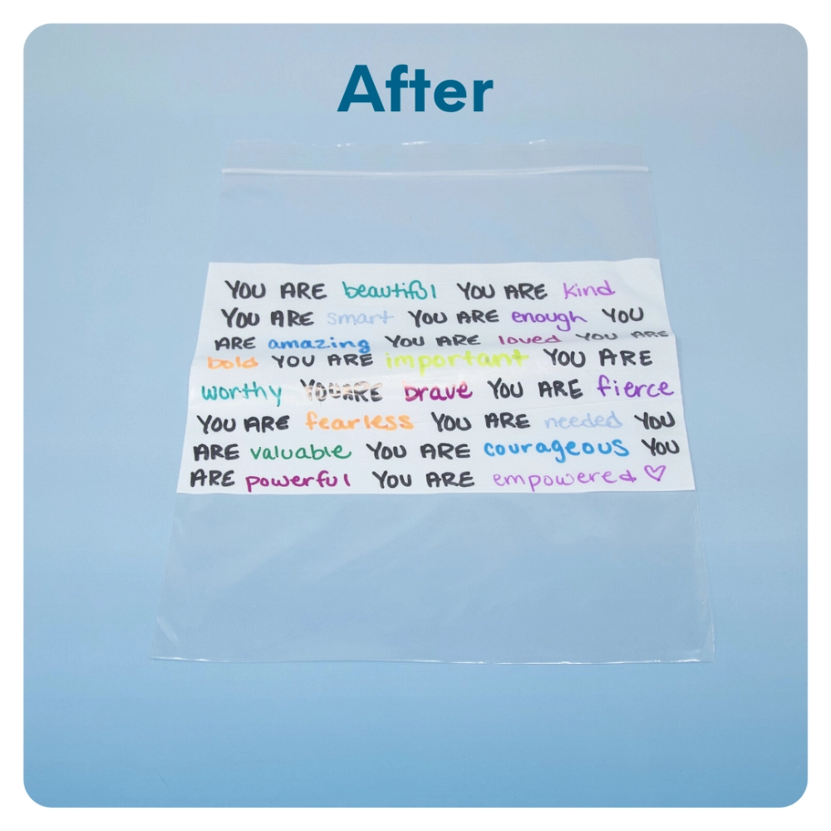
STEP 6 OF 10
Decorate the Bag (continued)

Slide 13
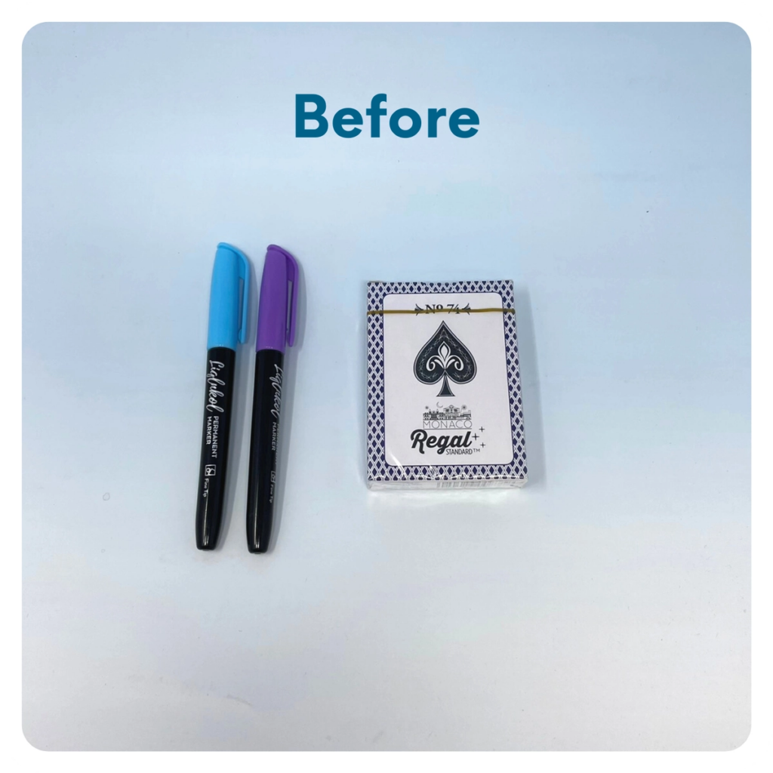
STEP 7 OF 10
Decorate the Playing Cards
Write encouraging messages, affirmations, jokes, or pictures on the faces of the playing cards for players to see when they are playing a card game.

Slide 14
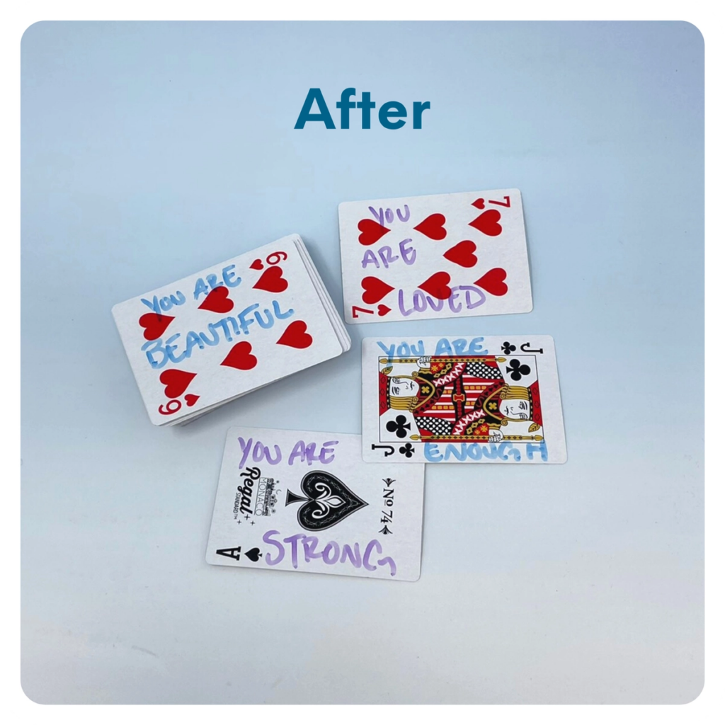
STEP 7 OF 10
Decorate the Playing Cards (continued)

Slide 15
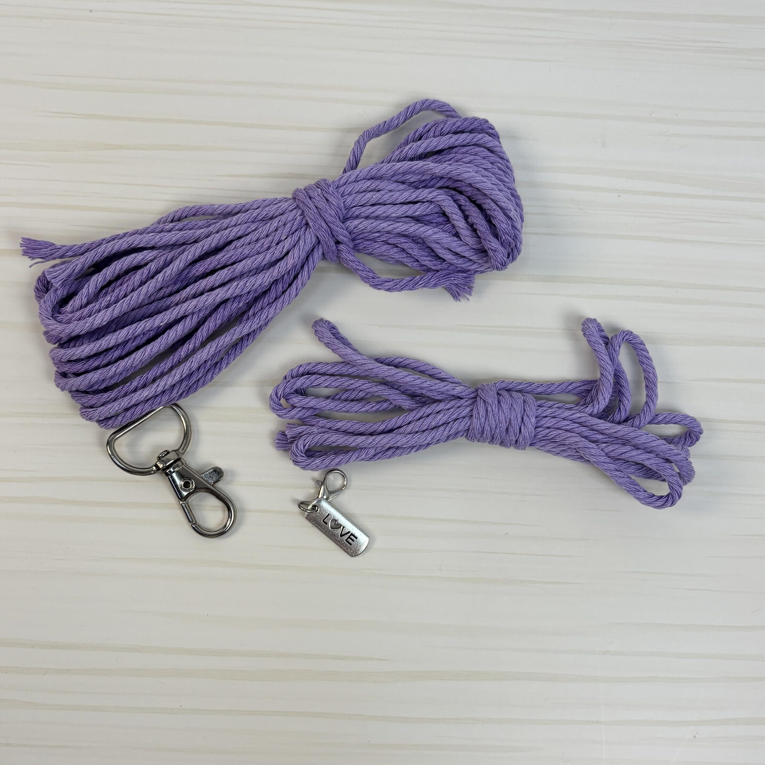
STEP 8 OF 10
DIY Macramé Wristlet Keychain
(video tutorial below)
WHAT'S INCLUDED
• 2 long cords (98" each)
• 1 short/finishing cord (note: there are 2 short cords in your kit, you will only use 1 of them)
• Key ring
• Inspirational charm
You'll also need: Scissors and a small piece of tape
LET'S GET STARTED!
1. Attach the cords to the key ring
note: These cords are folded off-center, not in half — this gives you 2 shorter center cords and 2 longer outer cords to knot with.

Slide 16
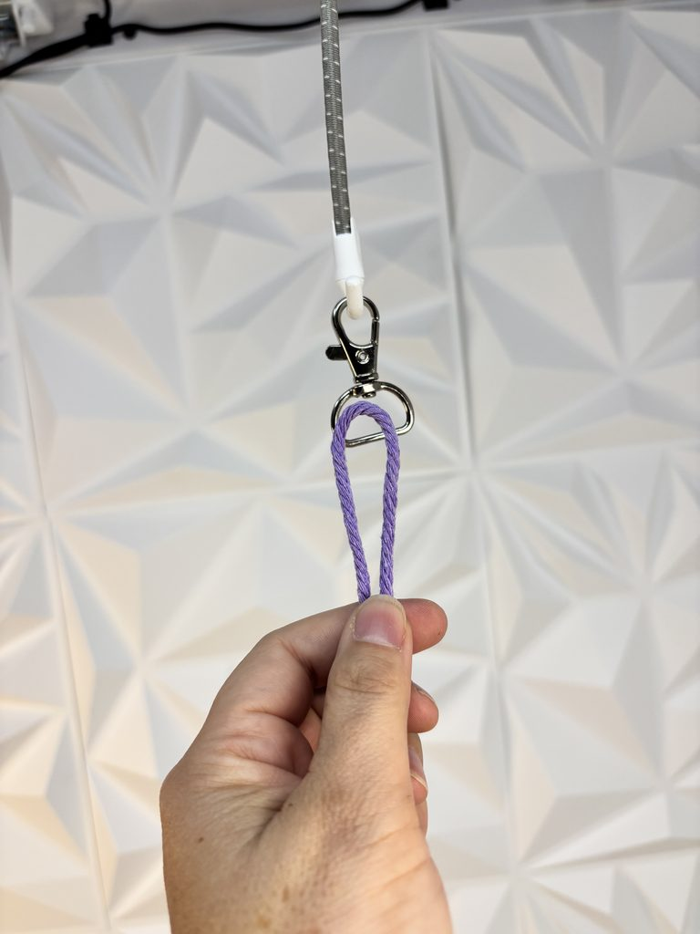
STEP 8 OF 10
DIY Macramé Wristlet Keychain (continued)
Take your first 98" cord. Measure in about 24" from one end (roughly a quarter of the way along the cord, don't worry if it's not exact) and fold it there. Place the fold through the key ring as a loop, then pull both loose ends through that loop and gently tighten. Position it so the short end sits on the right.
Take your second 98" cord and fold it the same way, about 24" from one end. Attach it to the key ring the same way, but this time position it so the short end sits on the left.
You should now have 4 cords hanging from the key ring: the two short ends meeting in the center, and the two long ends on the outside. Check that both center cords are roughly the same length — nudge the loops through the ring if you need to even them up.
2. Secure your key ring
Use a small piece of tape to hold the key ring in place on your work surface. This will make knotting easier.
3. Start knotting
Starting a couple of inches below the key ring, use the two outside cords to tie a square knot around the two center cords.
To make a square knot, start on the left or right:
First half:
• Bring the left cord over the two center cords and under the right cord.
• Bring the right cord under the center cords and up through the loop on the left.
• Pull gently to tighten holding the center cords in place.
Second half:
• Bring the right cord over the two center cords and under the left cord.
• Bring the left cord under the center cords and up through the loop on the right.
• Pull gently to tighten holding the center cords in place.
Both halves together make one complete square knot.
Pro tip: If you lose your spot, just look at your last knot — whichever side has the knot sitting on top is the side you start from next. If you mess up, just untie the last knot and start again.
4. Continue the square knots
Repeat the square knot down the length of the wristlet.
Keep your knots close together and try to keep the tension even as you work.
Continue until you have created a wristlet that feels comfortable to hold around your wrist, typical is 12-14 inches.
5. Fold the wristlet
When you've finished knotting, fold the wristlet in half so the two ends meet near the key ring.
Make sure the cords are lined up neatly.
6. Secure the wristlet
Take the short/finishing cord and make a loop with one end — at least the length of the gap you're covering. Lay the loop against the folded cords, then, going around to the left, wrap the cord around and around, stacking each row snugly under the next. Wrap at least 4 times, making sure to leave the opening of the loop free (don't wrap over it).
Once you've wrapped as much as you want, feed the working end of the cord through the loop. Pull the other end of the loop to tuck it up and back underneath the wraps, then pull tight to secure everything in place.
Trim each exposed end of the finishing cord close to the wraps — being careful not to trim the wrapped cord itself.
7. Finish your wristlet
You can trim all remaining cord flush, or cut some of it to leave a fringe — whichever look you like best.
8. Add your inspiration!
Add the inspirational charm to the key ring.
YOU DID IT! 💛
You've created your own macramé wristlet — a little reminder that doing good feels good.

Slide 17
STEP 9 OF 10
Pack Your AIT Cancer Support Kit
Pack all of the materials into the decorated kraft bag and put it back into the original box.
• Please only include items that are UNOPENED and UNUSED
Your kit will be returned to Project Helping where our team will quality check each kit before they are sent to Corporate Angel Network (CAN) for distribution.

Slide 18
STEP 10 OF 10
Thank You!
When you build a Kynd Kit, you create layers of impact for yourself and the community. We appreciate your time and your support of our mission.
Cheers,
The Project Helping team

